Slide 1
What’s the Sine Rule Ratio?
Inspired by a diagram on page 2 of The Penguin Dictionary of Curious and Interesting Geometry by David Wells.

Slide 2
What’s the Sine Rule Ratio?
$$D$$
$$θ°$$
Triangle $ABD$ is divided into two regions by straight line $EC$ which is $3$ units long.
The lengths of the line segments $ED$, $DC$ and $CB$ are shown.
Quadrilateral $ABCE$ is cyclic.
What is the value of $\frac{L}{\sin{θ}}$ ?
(Give your answer to 4 significant figures.)
$$5.7188$$
$$5.8602$$
$$E$$
$$C$$
$$3$$
$$7.4838$$
$$B$$
$$L$$
$$A$$
(Not to scale)
SIC_49
Notes:
5.8602 5.7188 7.4838

Slide 3
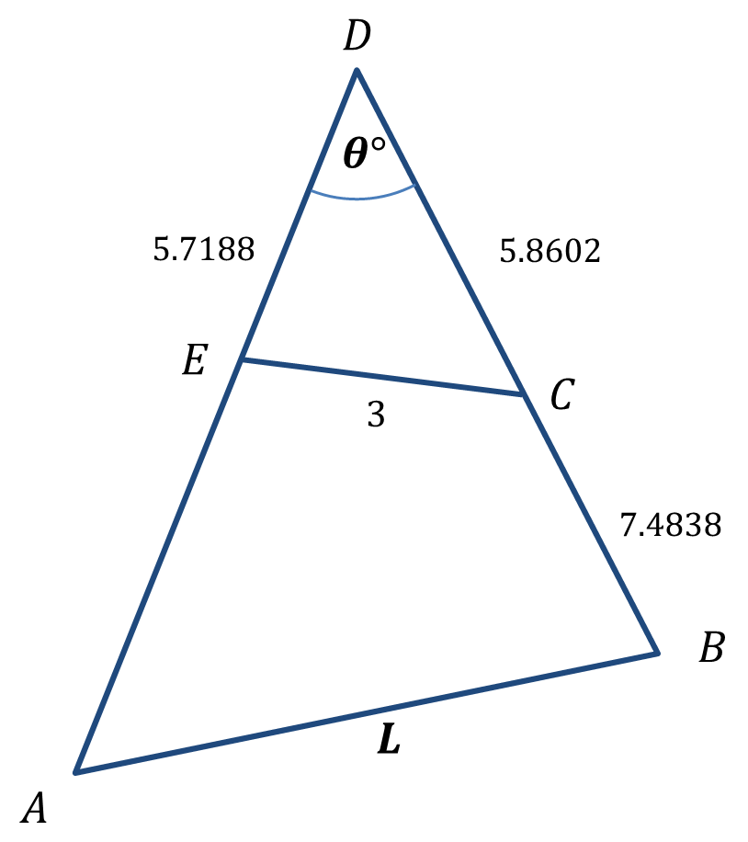
What’s the Sine Rule Ratio?
Here is one way:
Use the Cosine Rule to determine the value of $θ$.
$3^{2}={5.7188}^{2}+{5.8602}^{2}−2\left(5.7188\right)\left(5.8602\right)\cos{θ}$
$9=67.04661748−67.02662352\cos{θ}$
$\cos{θ=\frac{58.04661748}{67.02662352}}$
$\cos{θ=0.866023296}$
$θ=\cos^{−1}{0.866023296}$
$θ=30.00024143°$
SIC_49

Slide 4
What’s the Sine Rule Ratio?
Use a circle theorem to determine the value of $AE$.
“Quadrilateral $ABCE$ is cyclic.”
SIC_49

Slide 5
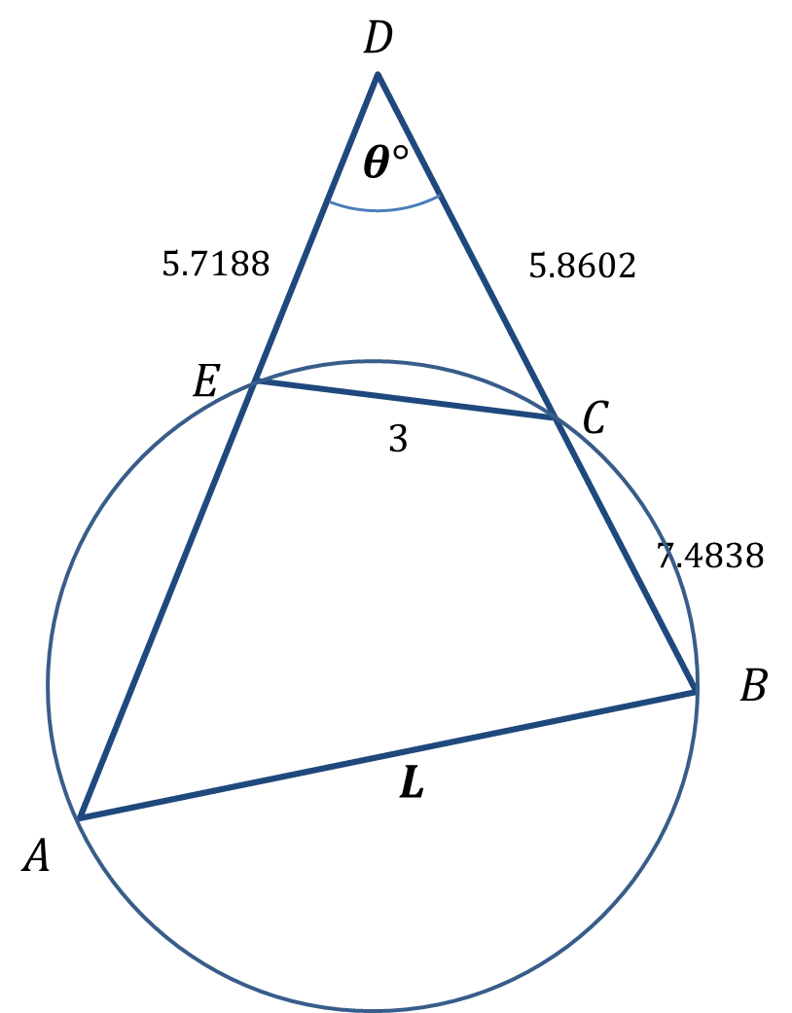
What’s the Sine Rule Ratio?
Use a circle theorem to determine the value of $AE$.
“Quadrilateral $ABCE$ is cyclic.”
Use the Intersecting Chords Theorem
$AD×ED=BD×CD$
$AD=\frac{BD×CD}{ED}$
$AE=\frac{BD×CD}{ED}−ED$
$AE=\frac{\left(5.8602+7.4838\right)\left(5.8602\right)}{5.7188}−5.7188$
$AE=7.95513663$
SIC_49

Slide 6
What’s the Sine Rule Ratio?
Use the Cosine Rule to determine the value of $L$.
$AD=AE+ED$ $BD=BC+CD$
$AD=13.67393663$ $BD=13.3440$
$L^{2}={13.67393663}^{2}+{13.344}^{2}$
$−2\left(13.67393663\right)\left(13.344\right)\cos{30.00024143°}$
$L^{2}=49.00097923$
$L=7.000069944$
$\frac{L}{\sin{θ}}=\frac{7.000069944}{\sin{30.00024143°}}=14.00003771$
$$7.95513663$$
$\frac{L}{\sin{θ}}=14$ (6 s.f.)
SIC_49

Slide 7
What’s the Sine Rule Ratio?
Another method would be to
determine angle $θ$ as before (cosine rule)
determine angle $ECD$ (sine rule)
determine angle $BCE$ (angles in a line sum to $180°$)
determine angle $BAD$ (opposite angles in a cyclic quadrilateral sum to $180°$)
finally determine $L$ using the sine rule with side $BD$, angle $BAD$ and $θ$.
SIC_49

Slide 8
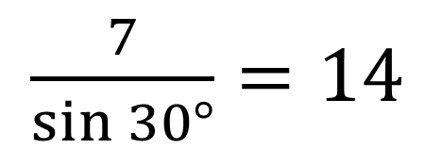
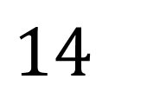
What’s the Sine Rule Ratio?
$$D$$
$\frac{7}{\sin{30°}}=14$
$$30°$$
$$5.7188$$
$$5.8602$$
What is the diameter of this circumcircle?
$$E$$
$$C$$
$$3$$
$$7.4838$$
$$7.95513663$$
$14$
$$B$$
$$7$$
$$A$$
(Not to scale)
SIC_49

Slide 9
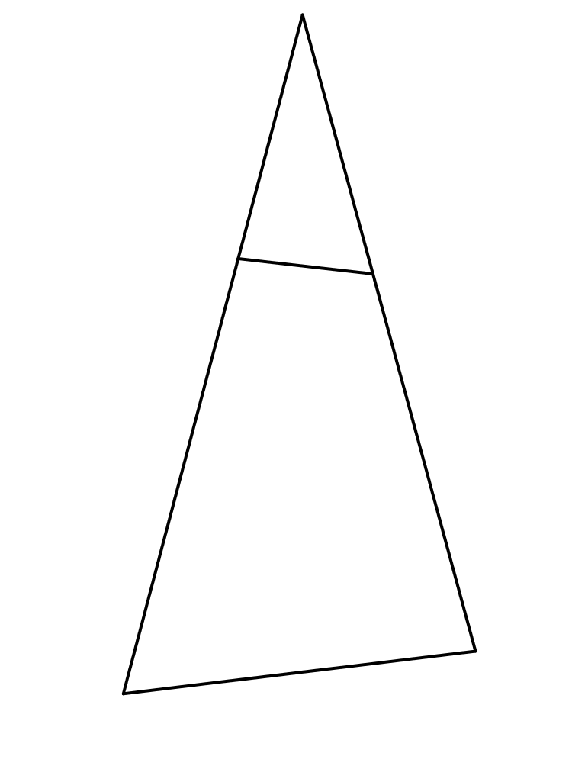
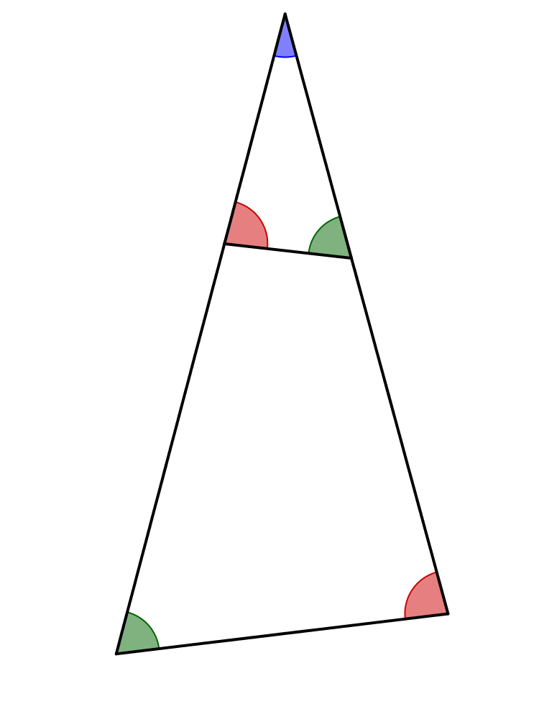
How was it possible to create the different problem sheets all with the same answer?
Who noticed that there are two similar triangles? Check on your diagram by calculation (since the diagrams are not to scale).
$$D$$
$$E$$
$$C$$
$$3$$
$$B$$
$$A$$
$$7$$

Slide 10
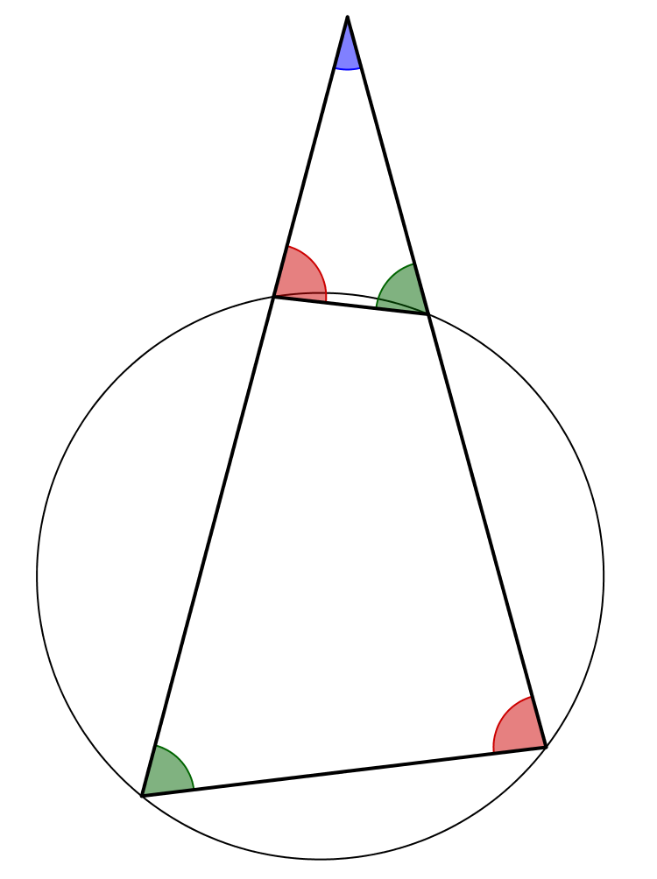
How was it possible to create the different problem sheets all with the same answer?
Quadrilateral $ABCE$ is cyclic.
$$D$$
$$E$$
$$C$$
$$3$$
$$B$$
$$A$$
$$7$$

Slide 11
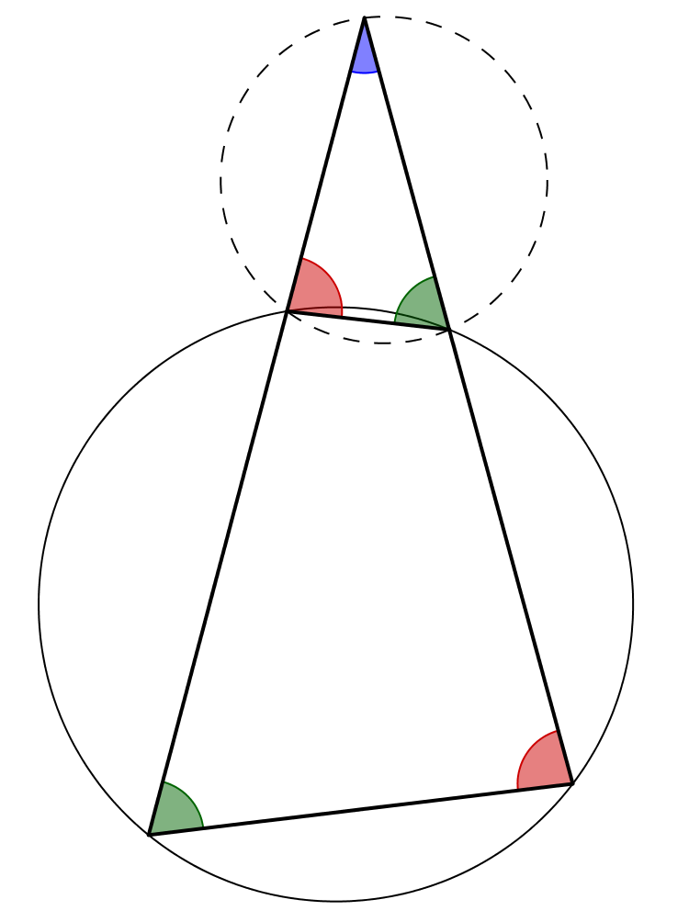
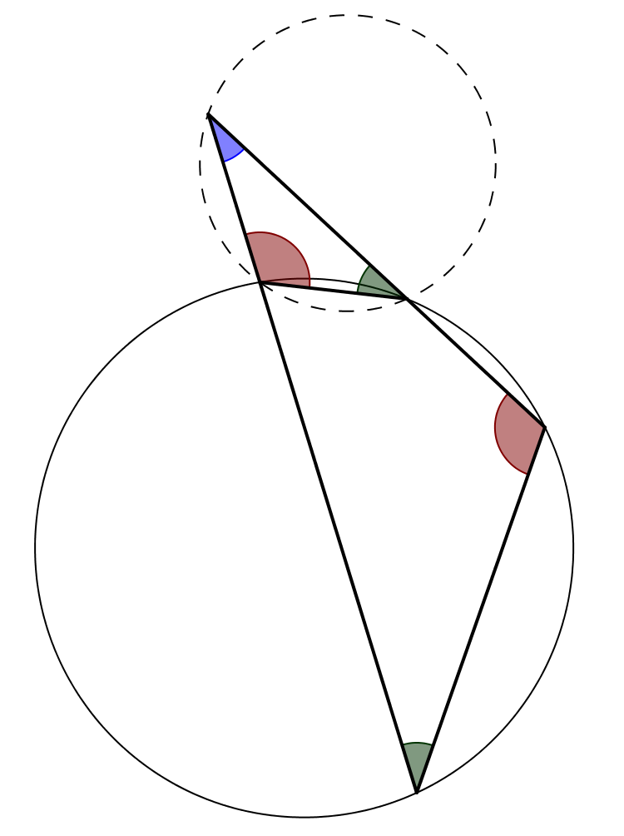
How was it possible to create the different problem sheets all with the same answer?
If we constrain point $D$ to be on the circumcircle shown we find that segments $AB$ and $A′B′$ are equal in length.
$$D$$
$$D′$$
$$E$$
$$C$$
$$E$$
$$C$$
$$3$$
$$3$$
$$B′$$
$$7$$
$$B$$
$$A$$
$$7$$
$$A′$$

Slide 12
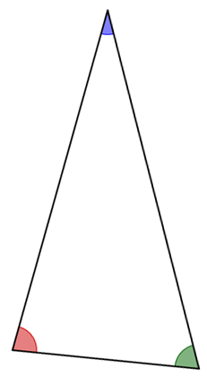
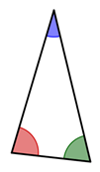
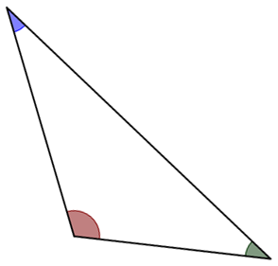
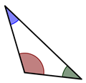
How was it possible to create the different problem sheets all with the same answer?
Triangles $ECD$ and $BAD$ are similar, as are triangles $ECD′$ and $B′A′D′$.
Since both triangles $ECD$ and $ECD′$ are inscribed in the same circle they have the same sine rule ratio (the diameter of that circle).
Since the angles are the same in the smaller and larger triangles in any scenario the scale factor between the two triangles is constant because one of the sides, $EC$, is fixed in length.
$$D$$
The enlargement scale factor is$\frac{BA}{EC}$ so since $EC$ is fixed $BA$ is constant in length.
$$D$$
$$D′$$
$$D′$$
$$E$$
$$3$$
$$C$$
$$E$$
$$3$$
$$C$$
$$B$$
$$B′$$
$$A$$
$$A′$$

Slide 14
Note to Teacher
The diameter of the circumcircle is addressed in SIC_2 Sine Rule Discovery.

Slide 15
RESOURCES

Slide 16
What’s the Sine Rule Ratio?
$$D$$
$$θ°$$
Triangle $ABD$ is divided into two regions by straight line $EC$ which is $3$ units long.
The lengths of the line segments $ED$, $DC$ and $CB$ are shown.
Quadrilateral $ABCE$ is cyclic.
What is the value of $\frac{L}{\sin{θ}}$ ?
(Give your answer to 4 significant figures.)
$$5.7192$$
$$5.8600$$
$$E$$
$$C$$
$$3$$
$$7.4848$$
$$B$$
$$L$$
$$A$$
(Not to scale)
SIC_49
Notes:
5.8600 5.7192 7.4848

Slide 17
What’s the Sine Rule Ratio?
$$D$$
$$θ°$$
Triangle $ABD$ is divided into two regions by straight line $EC$ which is $3$ units long.
The lengths of the line segments $ED$, $DC$ and $CB$ are shown.
Quadrilateral $ABCE$ is cyclic.
What is the value of $\frac{L}{\sin{θ}}$ ?
(Give your answer to 4 significant figures.)
$$5.9966$$
$$5.0921$$
$$E$$
$$C$$
$$3$$
$$8.9000$$
$$B$$
$$L$$
$$A$$
(Not to scale)
SIC_49
Notes:
5.0921 5.9966 8.9000

Slide 18
What’s the Sine Rule Ratio?
$$D$$
$$θ°$$
Triangle $ABD$ is divided into two regions by straight line $EC$ which is $3$ units long.
The lengths of the line segments $ED$, $DC$ and $CB$ are shown.
Quadrilateral $ABCE$ is cyclic.
What is the value of $\frac{L}{\sin{θ}}$ ?
(Give your answer to 4 significant figures.)
$$5.7195$$
$$5.8598$$
$$E$$
$$C$$
$$3$$
$$7.4857$$
$$B$$
$$L$$
$$A$$
(Not to scale)
SIC_49
Notes:
5.8598 5.7195 7.4857

Slide 19
What’s the Sine Rule Ratio?
$$D$$
$$θ°$$
Triangle $ABD$ is divided into two regions by straight line $EC$ which is $3$ units long.
The lengths of the line segments $ED$, $DC$ and $CB$ are shown.
Quadrilateral $ABCE$ is cyclic.
What is the value of $\frac{L}{\sin{θ}}$ ?
(Give your answer to 4 significant figures.)
$$5.9082$$
$$5.6395$$
$$E$$
$$C$$
$$3$$
$$8.1463$$
$$B$$
$$L$$
$$A$$
(Not to scale)
SIC_49
Notes:
5.6395 5.9082 8.1463

Slide 20
What’s the Sine Rule Ratio?
$$D$$
$$θ°$$
Triangle $ABD$ is divided into two regions by straight line $EC$ which is $3$ units long.
The lengths of the line segments $ED$, $DC$ and $CB$ are shown.
Quadrilateral $ABCE$ is cyclic.
What is the value of $\frac{L}{\sin{θ}}$ ?
(Give your answer to 4 significant figures.)
$$5.2205$$
$$5.9998$$
$$E$$
$$C$$
$$3$$
$$6.1814$$
$$B$$
$$L$$
$$A$$
(Not to scale)
SIC_49
Notes:
5.9998 5.2205 6.1814

Slide 21
What’s the Sine Rule Ratio?
$$D$$
$$θ°$$
Triangle $ABD$ is divided into two regions by straight line $EC$ which is $3$ units long.
The lengths of the line segments $ED$, $DC$ and $CB$ are shown.
Quadrilateral $ABCE$ is cyclic.
What is the value of $\frac{L}{\sin{θ}}$ ?
(Give your answer to 4 significant figures.)
$$5.5487$$
$$5.9468$$
$$E$$
$$C$$
$$3$$
$$7.0002$$
$$B$$
$$L$$
$$A$$
(Not to scale)
SIC_49
Notes:
5.9468 5.5487 7.0002

Slide 22
What’s the Sine Rule Ratio?
$$D$$
$$θ°$$
Triangle $ABD$ is divided into two regions by straight line $EC$ which is $3$ units long.
The lengths of the line segments $ED$, $DC$ and $CB$ are shown.
Quadrilateral $ABCE$ is cyclic.
What is the value of $\frac{L}{\sin{θ}}$ ?
(Give your answer to 4 significant figures.)
$$5.9822$$
$$4.9497$$
$$E$$
$$C$$
$$3$$
$$9.0088$$
$$B$$
$$L$$
$$A$$
(Not to scale)
SIC_49
Notes:
4.9497 5.9822 9.0088

Slide 23
What’s the Sine Rule Ratio?
$$D$$
$$θ°$$
Triangle $ABD$ is divided into two regions by straight line $EC$ which is $3$ units long.
The lengths of the line segments $ED$, $DC$ and $CB$ are shown.
Quadrilateral $ABCE$ is cyclic.
What is the value of $\frac{L}{\sin{θ}}$ ?
(Give your answer to 4 significant figures.)
$$5.7943$$
$$4.2392$$
$$E$$
$$C$$
$$3$$
$$9.2809$$
$$B$$
$$L$$
$$A$$
(Not to scale)
SIC_49
Notes:
4.2392 5.7943 9.2809

Slide 24
What’s the Sine Rule Ratio?
$$D$$
$$θ°$$
Triangle $ABD$ is divided into two regions by straight line $EC$ which is $3$ units long.
The lengths of the line segments $ED$, $DC$ and $CB$ are shown.
Quadrilateral $ABCE$ is cyclic.
What is the value of $\frac{L}{\sin{θ}}$ ?
(Give your answer to 4 significant figures.)
$$5.7085$$
$$4.0200$$
$$E$$
$$C$$
$$3$$
$$9.2999$$
$$B$$
$$L$$
$$A$$
(Not to scale)
SIC_49
Notes:
4.0200 5.7085 9.2999

Slide 25
What’s the Sine Rule Ratio?
$$D$$
$$θ°$$
Triangle $ABD$ is divided into two regions by straight line $EC$ which is $3$ units long.
The lengths of the line segments $ED$, $DC$ and $CB$ are shown.
Quadrilateral $ABCE$ is cyclic.
What is the value of $\frac{L}{\sin{θ}}$ ?
(Give your answer to 4 significant figures.)
$$5.8808$$
$$5.6880$$
$$E$$
$$C$$
$$3$$
$$8.0339$$
$$B$$
$$L$$
$$A$$
(Not to scale)
SIC_49
Notes:
5.6880 5.8808 8.0339

Slide 26
What’s the Sine Rule Ratio?
$$D$$
$$θ°$$
Triangle $ABD$ is divided into two regions by straight line $EC$ which is $3$ units long.
The lengths of the line segments $ED$, $DC$ and $CB$ are shown.
Quadrilateral $ABCE$ is cyclic.
What is the value of $\frac{L}{\sin{θ}}$ ?
(Give your answer to 4 significant figures.)
$$5.5073$$
$$5.9600$$
$$E$$
$$C$$
$$3$$
$$6.8904$$
$$B$$
$$L$$
$$A$$
(Not to scale)
SIC_49
Notes:
5.9600 5.5073 6.8904

Slide 27
What’s the Sine Rule Ratio?
$$D$$
$$θ°$$
Triangle $ABD$ is divided into two regions by straight line $EC$ which is $3$ units long.
The lengths of the line segments $ED$, $DC$ and $CB$ are shown.
Quadrilateral $ABCE$ is cyclic.
What is the value of $\frac{L}{\sin{θ}}$ ?
(Give your answer to 4 significant figures.)
$$4.6864$$
$$5.9319$$
$$E$$
$$C$$
$$3$$
$$5.0033$$
$$B$$
$$L$$
$$A$$
(Not to scale)
SIC_49
Notes:
5.9319 4.6865 5.0033

Slide 28
What’s the Sine Rule Ratio?
$$D$$
$$θ°$$
Triangle $ABD$ is divided into two regions by straight line $EC$ which is $3$ units long.
The lengths of the line segments $ED$, $DC$ and $CB$ are shown.
Quadrilateral $ABCE$ is cyclic.
What is the value of $\frac{L}{\sin{θ}}$ ?
(Give your answer to 4 significant figures.)
$$4.6786$$
$$5.9300$$
$$E$$
$$C$$
$$3$$
$$4.9868$$
$$B$$
$$L$$
$$A$$
(Not to scale)
SIC_49
Notes:
5.9300 4.6786 4.9868

Slide 29
What’s the Sine Rule Ratio?
$$D$$
$$θ°$$
Triangle $ABD$ is divided into two regions by straight line $EC$ which is $3$ units long.
The lengths of the line segments $ED$, $DC$ and $CB$ are shown.
Quadrilateral $ABCE$ is cyclic.
What is the value of $\frac{L}{\sin{θ}}$ ?
(Give your answer to 4 significant figures.)
$$5.5924$$
$$5.9300$$
$$E$$
$$C$$
$$3$$
$$7.1190$$
$$B$$
$$L$$
$$A$$
(Not to scale)
SIC_49
Notes:
5.9300 5.5924 7.1190

