Slide 1
Tetrahedron Nets
Vertical line in each diagram is the same length.

Slide 2
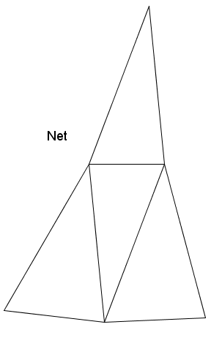

Slide 3
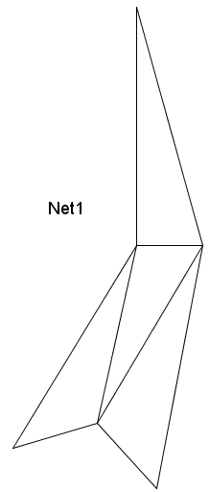

Slide 4
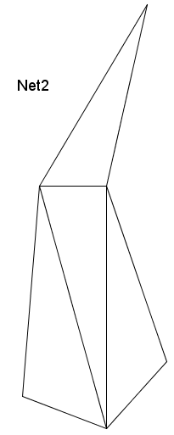

Slide 5
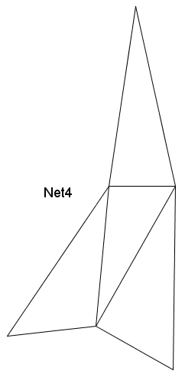

Slide 6
