Slide 1
Triangle xy area
Problem Solvers Handbook
Ex 3.5 Q7

Slide 2
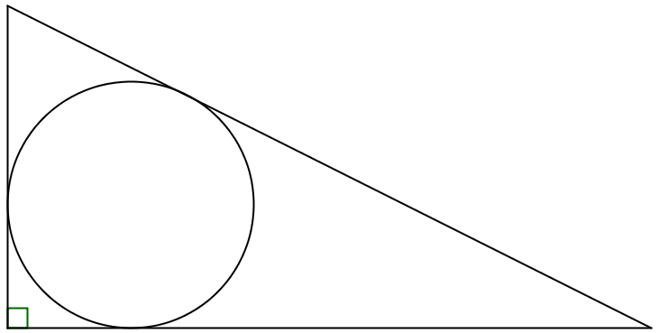
You are given the values of $x$ and $y$ .
What’s the area of the triangle?
$$x$$
(not to scale)
$$y$$
(The circle is tangent to the three sides of the triangle.)
Notes:
Area = $xy$

Slide 3
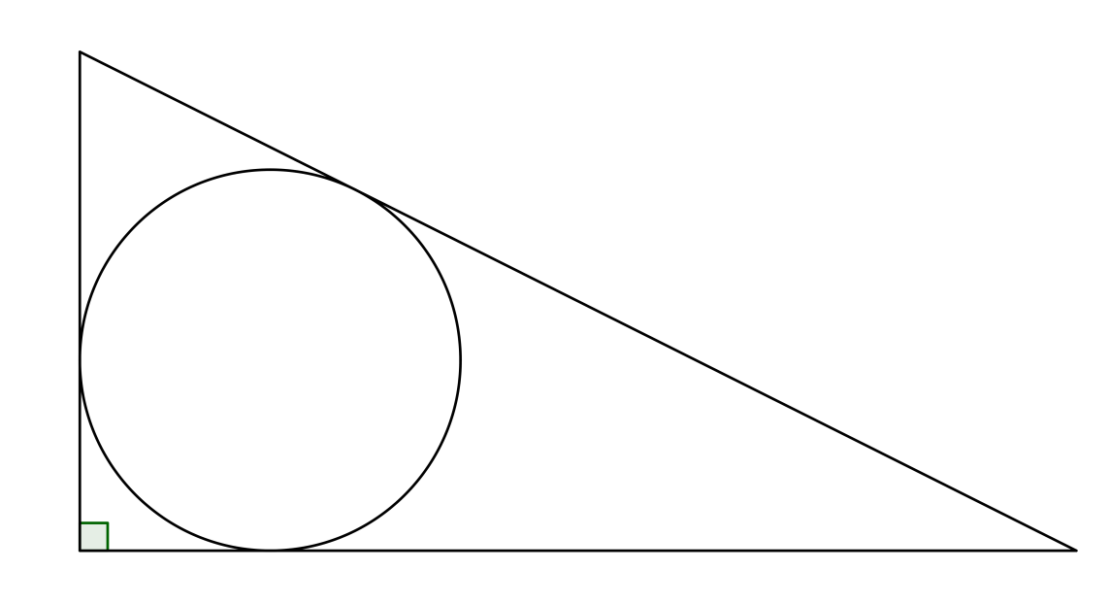
$$x$$
$$x$$
$$y$$
$$y$$
Notes:
Area = $xy$

Slide 4
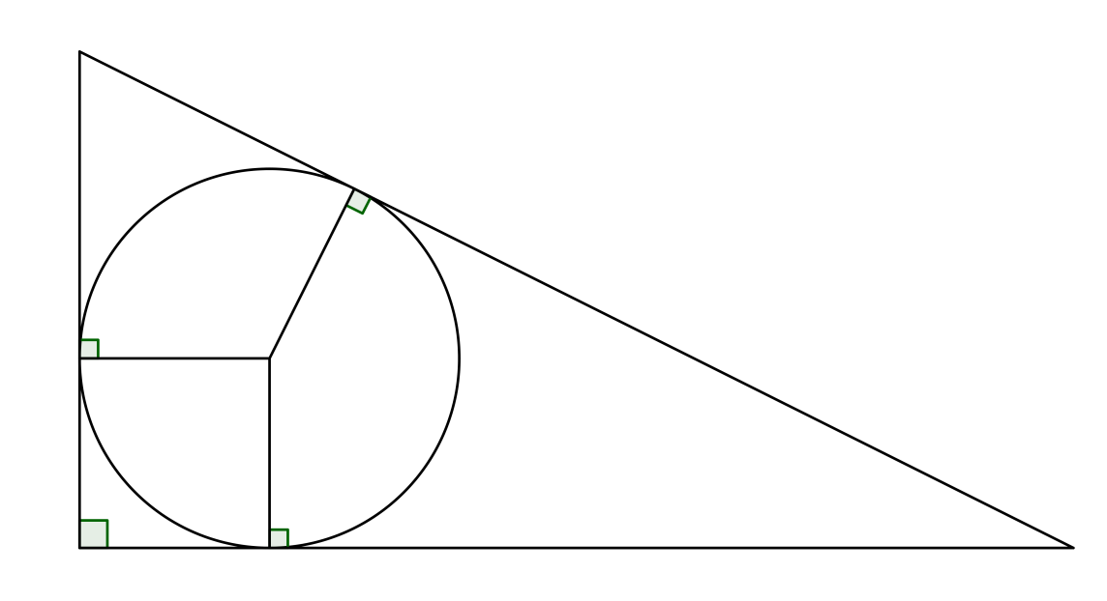
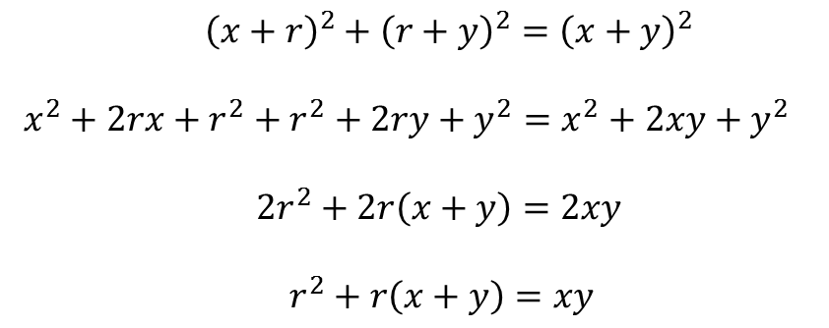
$$x$$
$$x$$
$$r$$
$$y$$
$$r$$
$$r$$
$$y$$
${\left(x+r\right)}^{2}+{\left(r+y\right)}^{2}={\left(x+y\right)}^{2}$
$x^{2}+2rx+r^{2}+r^{2}+2ry+y^{2}=x^{2}+2xy+y^{2}$
$2r^{2}+2r\left(x+y\right)=2xy$
$r^{2}+r\left(x+y\right)=xy$
(Pythagoras)

Slide 5
$$x$$
$$x$$
$$r$$
$$y$$
$$r$$
$$r$$
$$y$$

Slide 6
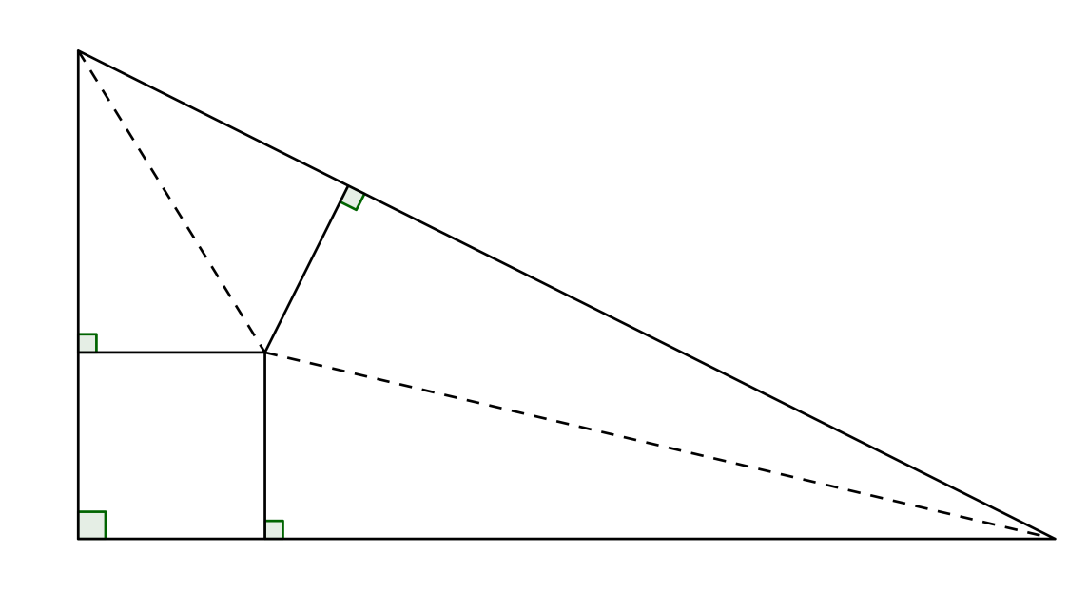
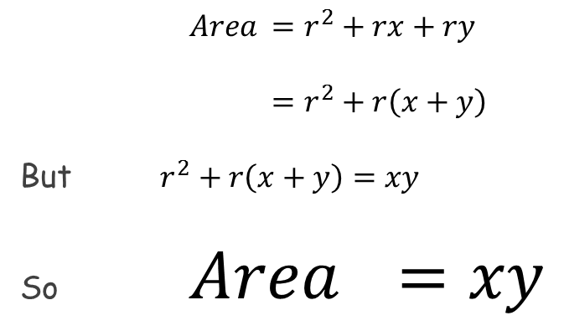
$$x$$
$$x$$
$$r$$
$$y$$
$$r$$
$$r$$
$$y$$
$Area$ $=r^{2}+rx+ry$
$=r^{2}+r\left(x+y\right)$
But $r^{2}+r\left(x+y\right)=xy$
So $Area$ $=xy$
(square and two kites)
(found previously)

Slide 7
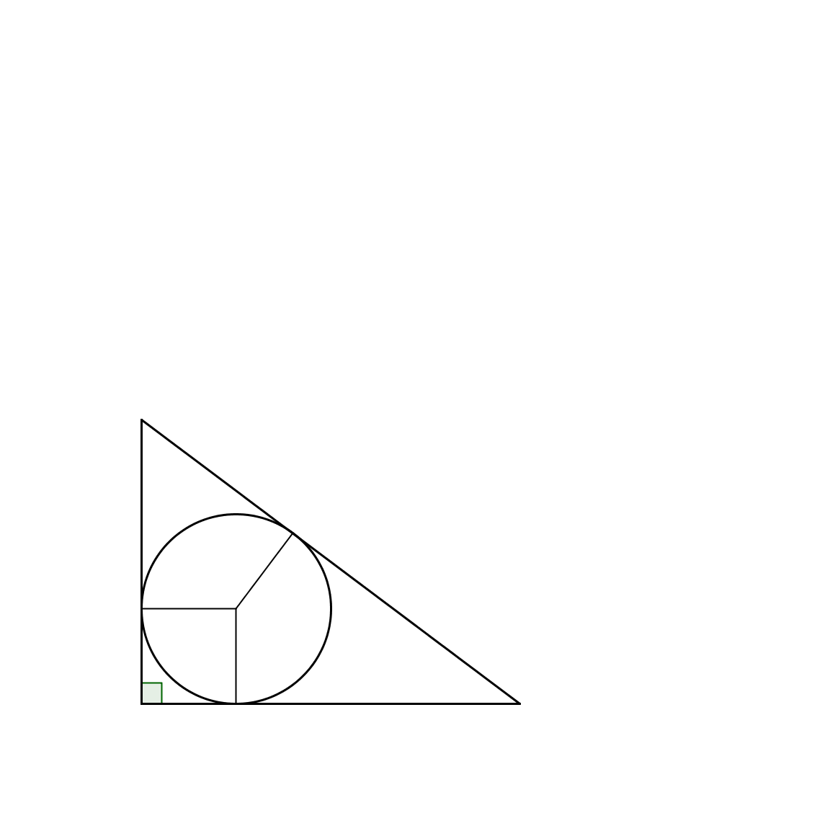
Supplementary:
What is the radius of the circle touching the three sides of the triangle?
$$3$$
$$r$$
$$4$$

Slide 8

Supplementary:
What is the radius of the circle touching the three sides of the triangle?
$$\frac{1}{2}\left(3\right)\left(4\right)=r^{2}+r\left(3−r\right)+r\left(4−r\right)$$
$$6=r^{2}+3r−r^{2}+4r−r^{2}$$
$$6=7r−r^{2}$$
$$r^{2}−7r+6=0$$
$$\left(r−1\right)\left(r−6\right)=0$$
So $r=1$ or $r=6$
$$3−r$$
$$3$$
$$r$$
$$r$$
$$4$$
$$r$$
$$4−r$$

Slide 9
Supplementary:
What is the radius of the circle touching the three sides of the triangle?
$$\frac{1}{2}\left(3\right)\left(4\right)=r^{2}+r\left(3−r\right)+r\left(4−r\right)$$
$$6=r^{2}+3r−r^{2}+4r−r^{2}$$
$$6=7r−r^{2}$$
$$r^{2}−7r+6=0$$
$$\left(r−1\right)\left(r−6\right)=0$$
So $r=1$ or $r=6$
$$3−r$$
$$2$$
$$r$$
$$1$$
$$1$$
$$r$$
$$1$$
$$4−r$$
$$r$$
$$3$$
But what about the other answer?

Slide 10
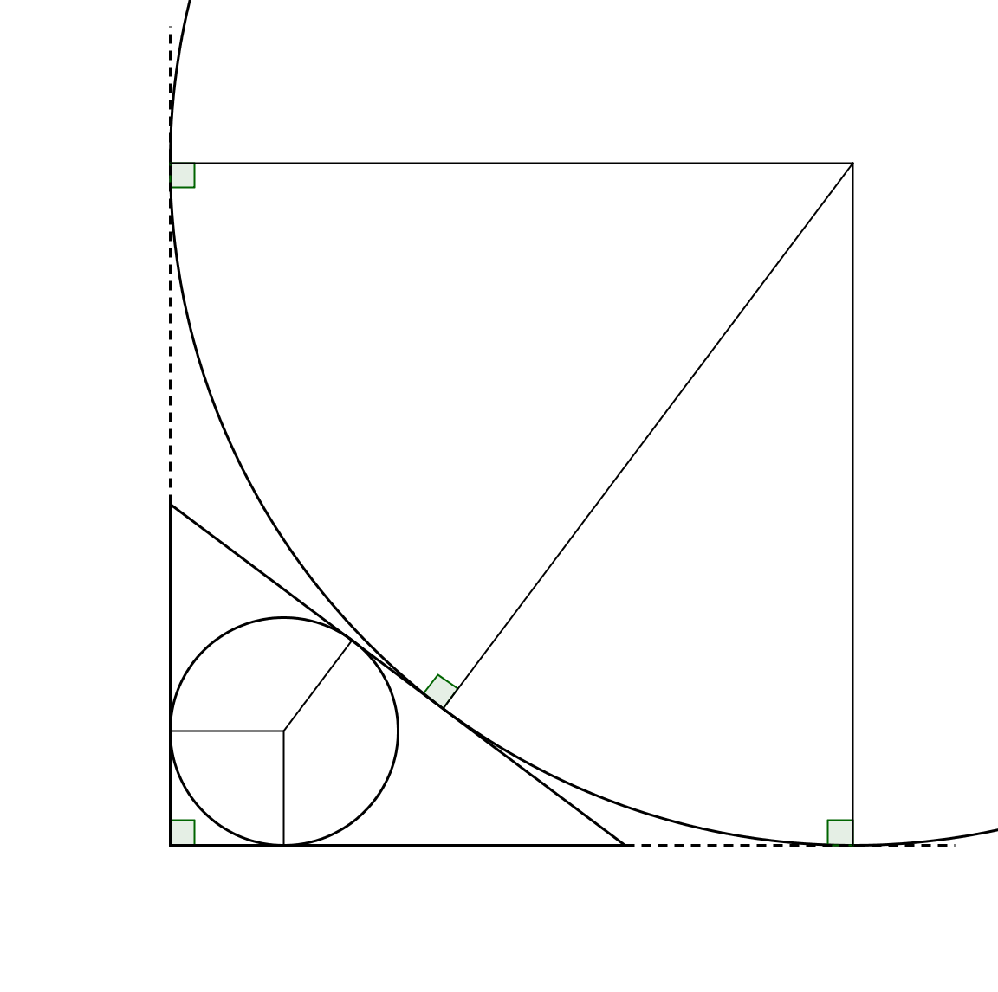
$$6$$
$$6$$
$$6$$
$$1$$
But why did algebra bring up this answer?

Slide 11
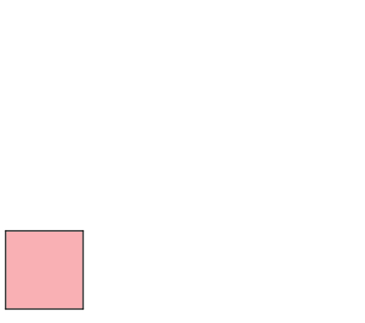
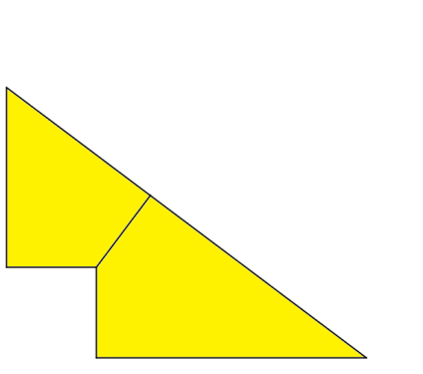
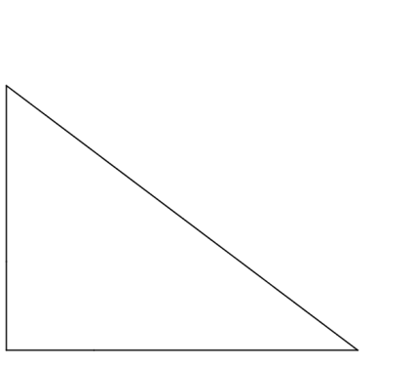
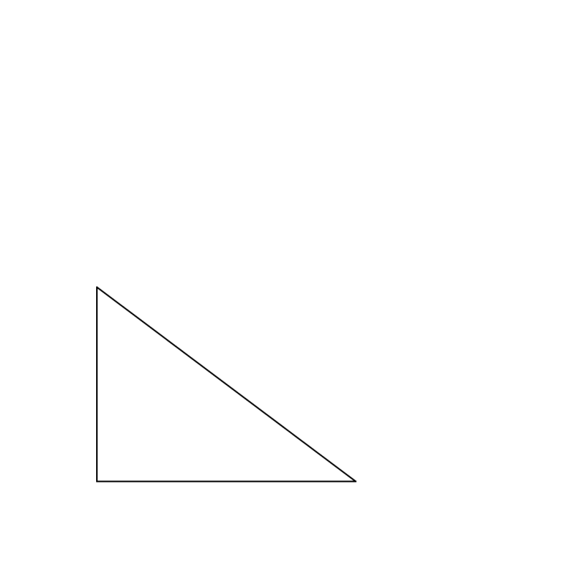
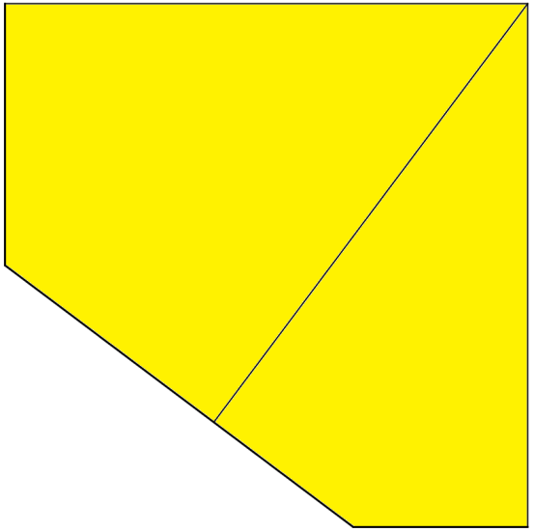
$$r=1$$
$$3$$
$$4$$
$$r=6$$
$$3$$
$$4$$

Slide 13
Resources

Slide 14
What’s the area of the triangle?
$$2$$
(not to scale)
$$4$$
(The circle is tangent to the three sides of the triangle.)
SIC_11

Slide 15
What’s the area of the triangle?
$$3$$
(not to scale)
$$5$$
(The circle is tangent to the three sides of the triangle.)
SIC_11

Slide 16
What’s the area of the triangle?
$$6$$
(not to scale)
$$8$$
(The circle is tangent to the three sides of the triangle.)
SIC_11

Slide 17
What’s the area of the triangle?
$$3$$
(not to scale)
$$6$$
(The circle is tangent to the three sides of the triangle.)
SIC_11

Slide 18
What’s the area of the triangle?
$$2$$
(not to scale)
$$5$$
(The circle is tangent to the three sides of the triangle.)
SIC_11

Slide 19
What’s the area of the triangle?
$$3$$
(not to scale)
$$7$$
(The circle is tangent to the three sides of the triangle.)
SIC_11

Slide 20

What’s the area of the triangle?
$$6$$
(not to scale)
$$10$$
(The circle is tangent to the three sides of the triangle.)
SIC_11

Slide 21
What’s the area of the triangle?
$$3$$
(not to scale)
$$8$$
(The circle is tangent to the three sides of the triangle.)
SIC_11

Slide 22
What’s the area of the triangle?
$$2$$
(not to scale)
$$3$$
(The circle is tangent to the three sides of the triangle.)
SIC_11

Slide 23
What’s the area of the triangle?
$$4$$
(not to scale)
$$6$$
(The circle is tangent to the three sides of the triangle.)
SIC_11

Slide 24
What’s the area of the triangle?
$$6$$
(not to scale)
$$9$$
(The circle is tangent to the three sides of the triangle.)
SIC_11

Slide 25

What’s the area of the triangle?
$$8$$
(not to scale)
$$12$$
(The circle is tangent to the three sides of the triangle.)
SIC_11

Slide 26
What’s the area of the triangle?
$$5$$
(not to scale)
$$7$$
(The circle is tangent to the three sides of the triangle.)
SIC_11

Slide 27
What’s the area of the triangle?
$$6$$
(not to scale)
$$7$$
(The circle is tangent to the three sides of the triangle.)
SIC_11

Slide 28
What’s the area of the triangle?
$$2$$
(not to scale)
$$7$$
(The circle is tangent to the three sides of the triangle.)
SIC_11

Slide 29
What’s the area of the triangle?
$$7$$
(not to scale)
$$9$$
(The circle is tangent to the three sides of the triangle.)
SIC_11

