Slide 1
The Shortest Race

Slide 2
The Shortest Race
You have to race from one tree (call it A) to another (call it B) and touch a nearby fence (at point P, say) on the way.
Where should you touch the fence to minimise the distance you have to run?

Slide 3
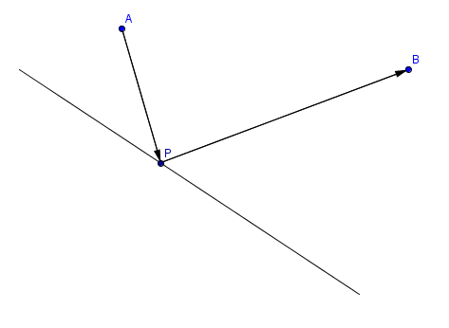
This diagram models the general case.
fence

Slide 4
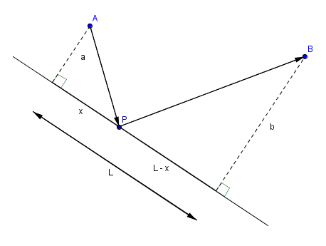
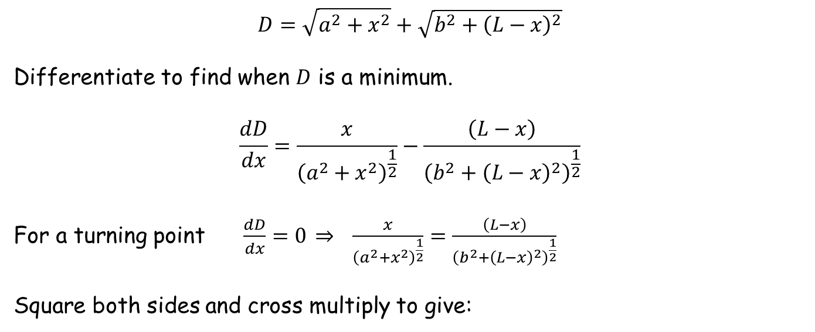
This diagram models the general case.
The problem is now one of finding the value of $x$ that makes the length AP + PB a minimum.
Call this length $D$.
fence
$$D=\sqrt{a^{2}+x^{2}}+\sqrt{b^{2}+{\left(L−x\right)}^{2}}$$
Differentiate to find when $D$ is a minimum.
$$\frac{dD}{dx}=\frac{x}{{\left(a^{2}+x^{2}\right)}^{\frac{1}{2}}}−\frac{\left(L−x\right)}{{\left(b^{2}+{\left(L−x\right)}^{2}\right)}^{\frac{1}{2}}}$$
For a turning point $\frac{dD}{dx}=0 \underset{⇒}{} \frac{x}{{\left(a^{2}+x^{2}\right)}^{\frac{1}{2}}}=\frac{\left(L−x\right)}{{\left(b^{2}+{\left(L−x\right)}^{2}\right)}^{\frac{1}{2}}}$
Square both sides and cross multiply to give:

Slide 5

$x^{2}\left(b^{2}+{\left(L−x\right)}^{2}\right)={\left(L−x\right)}^{2}\left(a^{2}+x^{2}\right)$
$b^{2}x^{2}+x^{2}{\left(L−x\right)}^{2}=a^{2}{\left(L−x\right)}^{2}+x^{2}{\left(L−x\right)}^{2}$
$b^{2}x^{2}=a^{2}\left(L^{2}−2Lx+x^{2}\right)$
$\left(b^{2}−a^{2}\right)x^{2}+2a^{2}Lx−a^{2}L^{2}=0$
$x=\frac{−2a^{2}L±\sqrt{4a^{4}L^{2}+4\left(b^{2}−a^{2}\right)a^{2}L^{2}}}{2\left(b^{2}−a^{2}\right)}$
$x=\frac{−a^{2}L±abL}{\left(b^{2}−a^{2}\right)}$
$x=\frac{\left(−a±b\right)aL}{\left(b^{2}−a^{2}\right)}$
$x=\frac{\left(b−a\right)aL}{\left(b^{2}−a^{2}\right)}$ (ignore negative solution)
$x=\left(\frac{a}{a+b}\right)L$

Slide 6
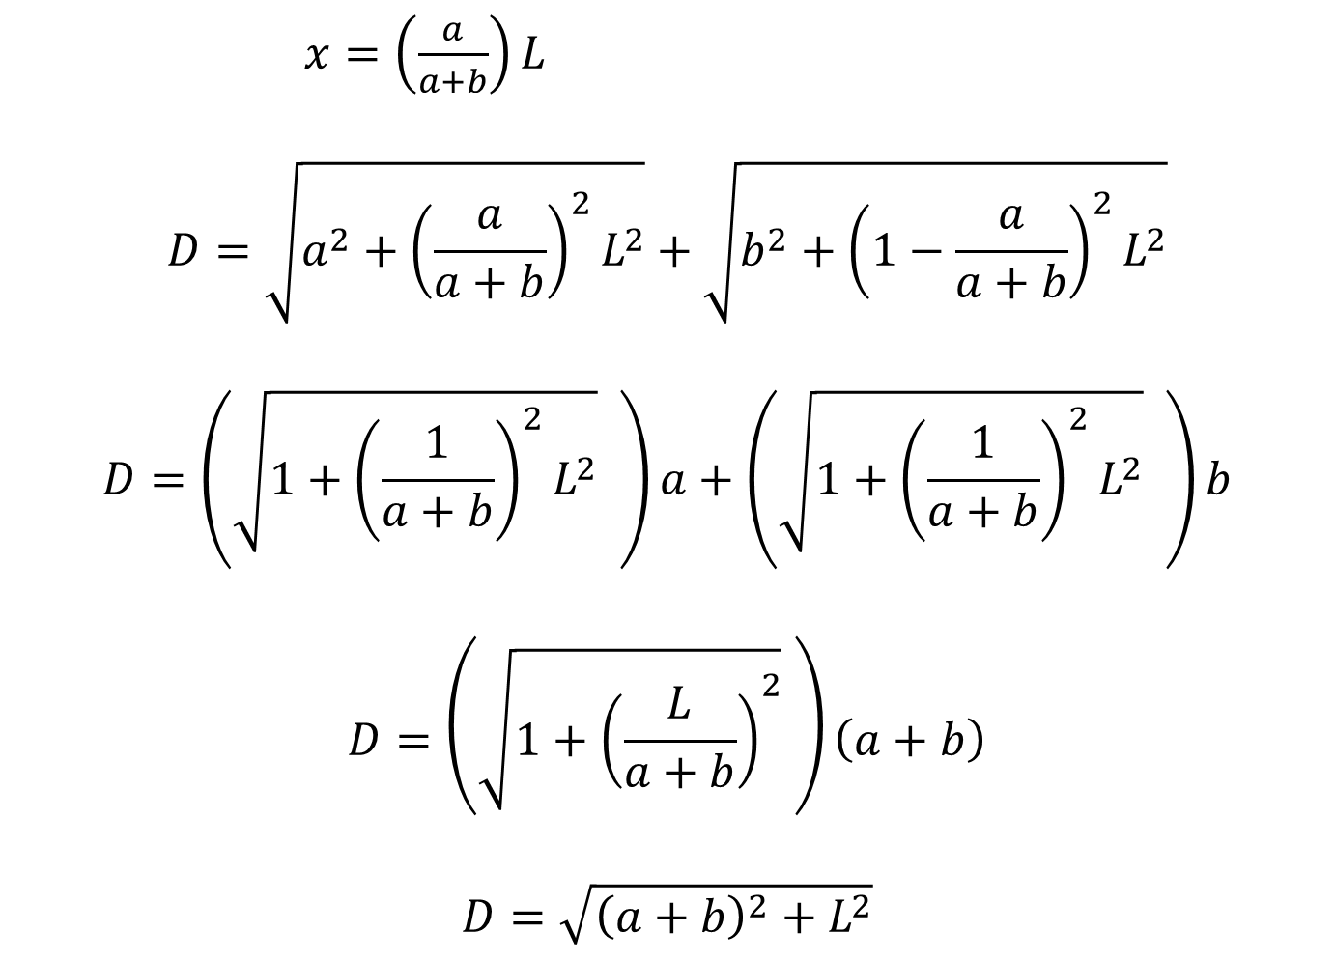
$x=\left(\frac{a}{a+b}\right)L$
$$D=\sqrt{a^{2}+{\left(\frac{a}{a+b}\right)}^{2}L^{2}}+\sqrt{b^{2}+{\left(1−\frac{a}{a+b}\right)}^{2}L^{2}}$$
$$D=\left(\sqrt{1+{\left(\frac{1}{a+b}\right)}^{2}L^{2}} \right)a+\left(\sqrt{1+{\left(\frac{1}{a+b}\right)}^{2}L^{2}} \right)b$$
$$D=\left(\sqrt{1+{\left(\frac{L}{a+b}\right)}^{2}} \right)\left(a+b\right)$$
$$D=\sqrt{{\left(a+b\right)}^{2}+L^{2}}$$

Slide 7
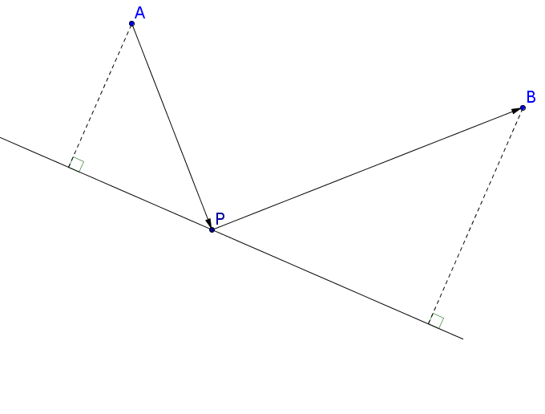

For the minimum distance race (shown below), analysing the angle at P in both triangles shows that they are the same.
$$θ$$
$$a$$
$$θ$$
$$\left(\frac{a}{a+b}\right)L$$
$$θ$$
$$b$$
$$\left(\frac{b}{a+b}\right)L$$

Slide 8

So another way to solve the problem is to simply reflect point A in the fence line to give A’ and join it to point B. Where line A’B crosses the fence line is the solution since length A’P equals length AP.
$$θ$$
$$a$$
$$θ$$
$$\left(\frac{a}{a+b}\right)L$$
$$θ$$
$$b$$
$$\left(\frac{b}{a+b}\right)L$$

Slide 9
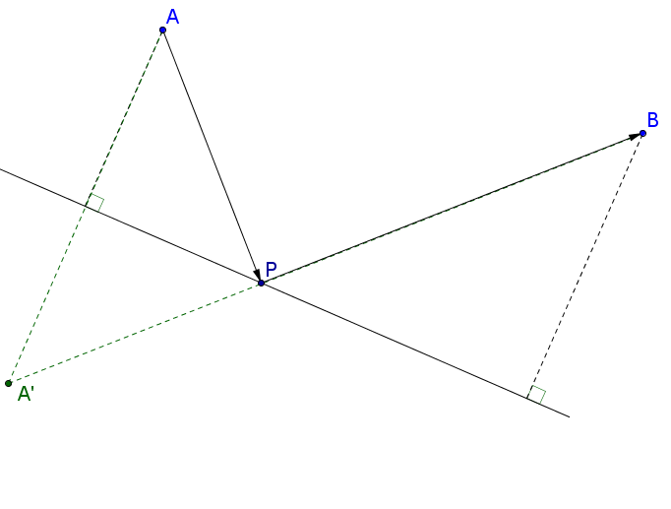

So another way to solve the problem is to simply reflect point A in the fence line to give A’ and join it to point B. Where line A’B crosses the fence line is the solution since length A’P equals length AP.
$$a$$
$$θ$$
$$\left(\frac{a}{a+b}\right)L$$
$$θ$$
$$b$$
$$\left(\frac{b}{a+b}\right)L$$
And a straight line is the shortest distance between two points.

Slide 10
Resources

Slide 11
fence

Slide 12
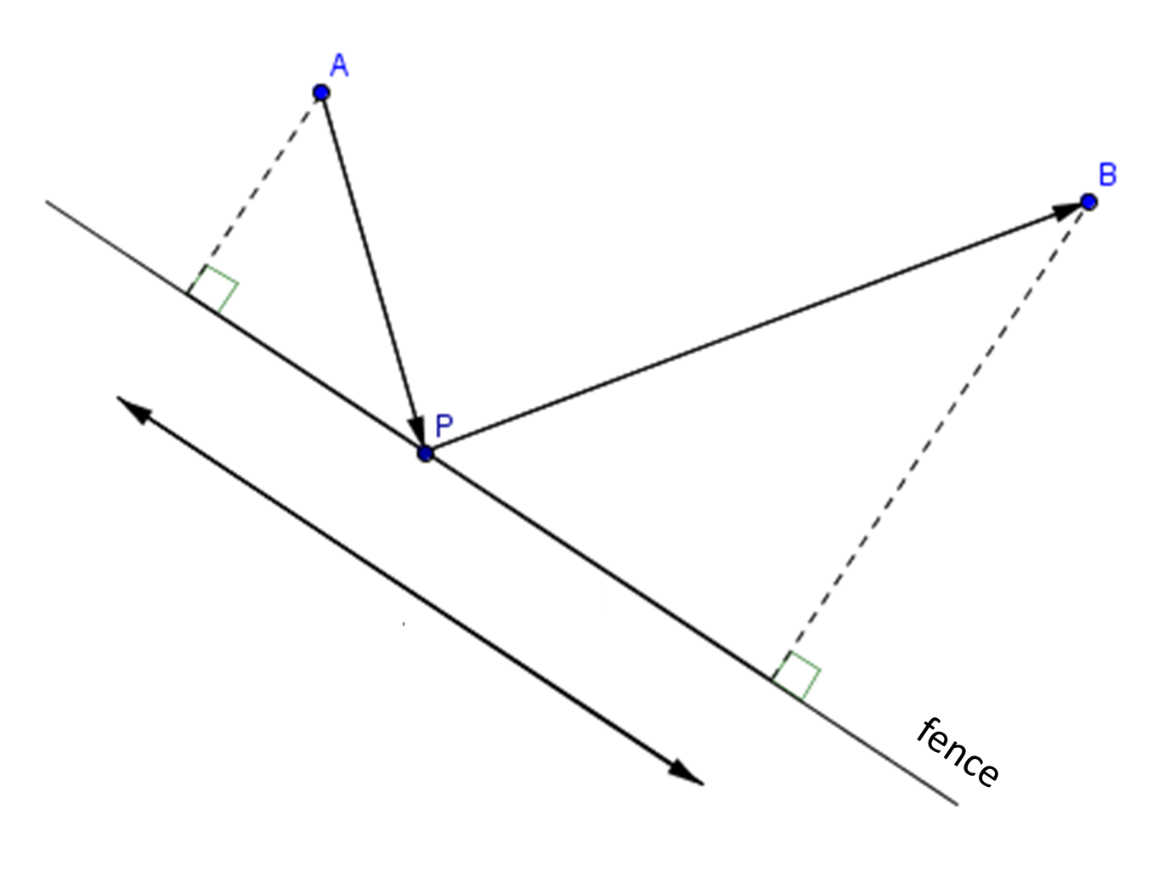
33 m
The Shortest Race
80 m
What’s the shortest distance race?
27 m

Slide 13
SIC_22
SIC_22
33 m
36 m
The Shortest Race
The Shortest Race
80 m
80 m
What’s the shortest distance race?
What’s the shortest distance race?
27 m
24 m
Not to scale
Not to scale

Slide 14
SIC_22
SIC_22
39 m
42 m
The Shortest Race
The Shortest Race
80 m
80 m
What’s the shortest distance race?
What’s the shortest distance race?
21 m
18 m
Not to scale
Not to scale

Slide 15
SIC_22
SIC_22
51 m
57 m
The Shortest Race
The Shortest Race
80 m
80 m
What’s the shortest distance race?
What’s the shortest distance race?
9 m
3 m
Not to scale
Not to scale

Slide 16
SIC_22
SIC_22
45 m
50 m
The Shortest Race
The Shortest Race
80 m
80 m
What’s the shortest distance race?
What’s the shortest distance race?
15 m
10 m
Not to scale
Not to scale

Slide 17
SIC_22
SIC_22
54 m
48 m
The Shortest Race
The Shortest Race
80 m
80 m
What’s the shortest distance race?
What’s the shortest distance race?
6 m
12 m
Not to scale
Not to scale

Slide 18
SIC_22
SIC_22
43 m
37 m
The Shortest Race
The Shortest Race
80 m
80 m
What’s the shortest distance race?
What’s the shortest distance race?
17 m
23 m
Not to scale
Not to scale

Slide 19
SIC_22
SIC_22
43 m
46 m
The Shortest Race
The Shortest Race
60 m
60 m
What’s the shortest distance race?
What’s the shortest distance race?
37 m
34 m
Not to scale
Not to scale

Slide 20
SIC_22
SIC_22
49 m
52 m
The Shortest Race
The Shortest Race
60 m
60 m
What’s the shortest distance race?
What’s the shortest distance race?
31 m
28 m
Not to scale
Not to scale

Slide 21
SIC_22
SIC_22
61 m
67 m
The Shortest Race
The Shortest Race
60 m
60 m
What’s the shortest distance race?
What’s the shortest distance race?
19 m
13 m
Not to scale
Not to scale

Slide 22
SIC_22
SIC_22
55 m
60 m
The Shortest Race
The Shortest Race
60 m
60 m
What’s the shortest distance race?
What’s the shortest distance race?
25 m
20 m
Not to scale
Not to scale

Slide 23
SIC_22
SIC_22
64 m
58 m
The Shortest Race
The Shortest Race
60 m
60 m
What’s the shortest distance race?
What’s the shortest distance race?
16 m
22 m
Not to scale
Not to scale

Slide 24
SIC_22
SIC_22
53 m
47 m
The Shortest Race
The Shortest Race
60 m
60 m
What’s the shortest distance race?
What’s the shortest distance race?
27 m
33 m
Not to scale
Not to scale

Slide 25
