Slide 1
Skew Lines

Slide 2


Skew Lines
The two given lines given are skew (i.e. they do not meet).
What is the shortest distance between them?
$$P$$
$$L_{1}=\left(\begin{matrix}5 \\ −4 \\ 5\end{matrix}\right)+λ\left(\begin{matrix}2 \\ −3 \\ 2\end{matrix}\right)$$
$$L_{2}=\left(\begin{matrix}10 \\ 2 \\ 10\end{matrix}\right)+μ\left(\begin{matrix}−2 \\ 2 \\ −1\end{matrix}\right)$$
shortest distance
$$Q$$
Also find the co-ordinates of $P$ and $Q$.

Slide 3
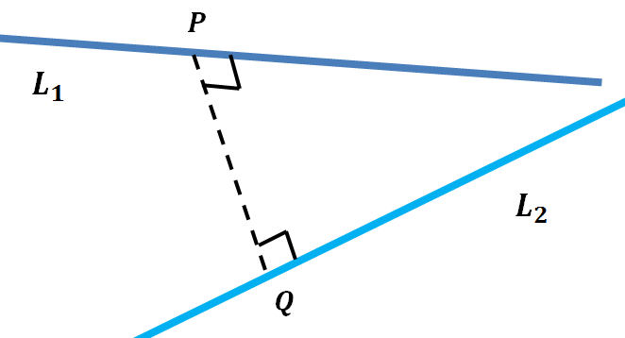
$\vec{PQ}$ must be perpendicular to both lines.
Let $\vec{PQ}=\left(\begin{matrix}a \\ b \\ c\end{matrix}\right)$
Then $\left(\begin{matrix}a \\ b \\ c\end{matrix}\right).\left(\begin{matrix}2 \\ −3 \\ 2\end{matrix}\right)=0$ $\underset{⇒}{} 2a−3b+2c=0$ (1)
And $\left(\begin{matrix}a \\ b \\ c\end{matrix}\right).\left(\begin{matrix}−2 \\ 2 \\ −1\end{matrix}\right)=0$ $\underset{⇒}{} −2a+2b−c=0$ (2)
We have two equations but three unknowns so they cannot be solved but we don’t need to, we only need find the relative sizes of them.
Adding equations (1) and (2) gives $c=b$ and substitution gives $b=2a$.
So $\vec{PQ}=n\left(\begin{matrix}1 \\ 2 \\ 2\end{matrix}\right)$ with magnitude $3n$ where $n$ is some number.

Slide 4
Let $P^{′}$and $Q^{′}$ be general points on $L_{1}$ and $L_{2}$, respectively.
The coordinates of each are:
$P^{′}=\left(5+2λ, −4−3λ, 5+2λ\right)$ $Q^{′}=\left(10−2μ, 2+2μ, 10−μ\right)$.
The vector joining these points is:
$\vec{P^{′}Q^{′}}=\left(\begin{matrix}(10−2μ)−\left(5+2λ\right) \\ (2+2μ)−\left(−4−3λ\right) \\ (10−μ)−\left(5+2λ\right)\end{matrix}\right)=\left(\begin{matrix}5−2μ−2λ \\ 6+2μ+3λ \\ 5−μ−2λ\end{matrix}\right)$
This must be parallel to $\vec{PQ}$ so:
$$\left(\begin{matrix}5−2μ−2λ \\ 6+2μ+3λ \\ 5−μ−2λ\end{matrix}\right)=n\left(\begin{matrix}1 \\ 2 \\ 2\end{matrix}\right)$$
This gives us three equations with three unknowns which we can solve.

Slide 5
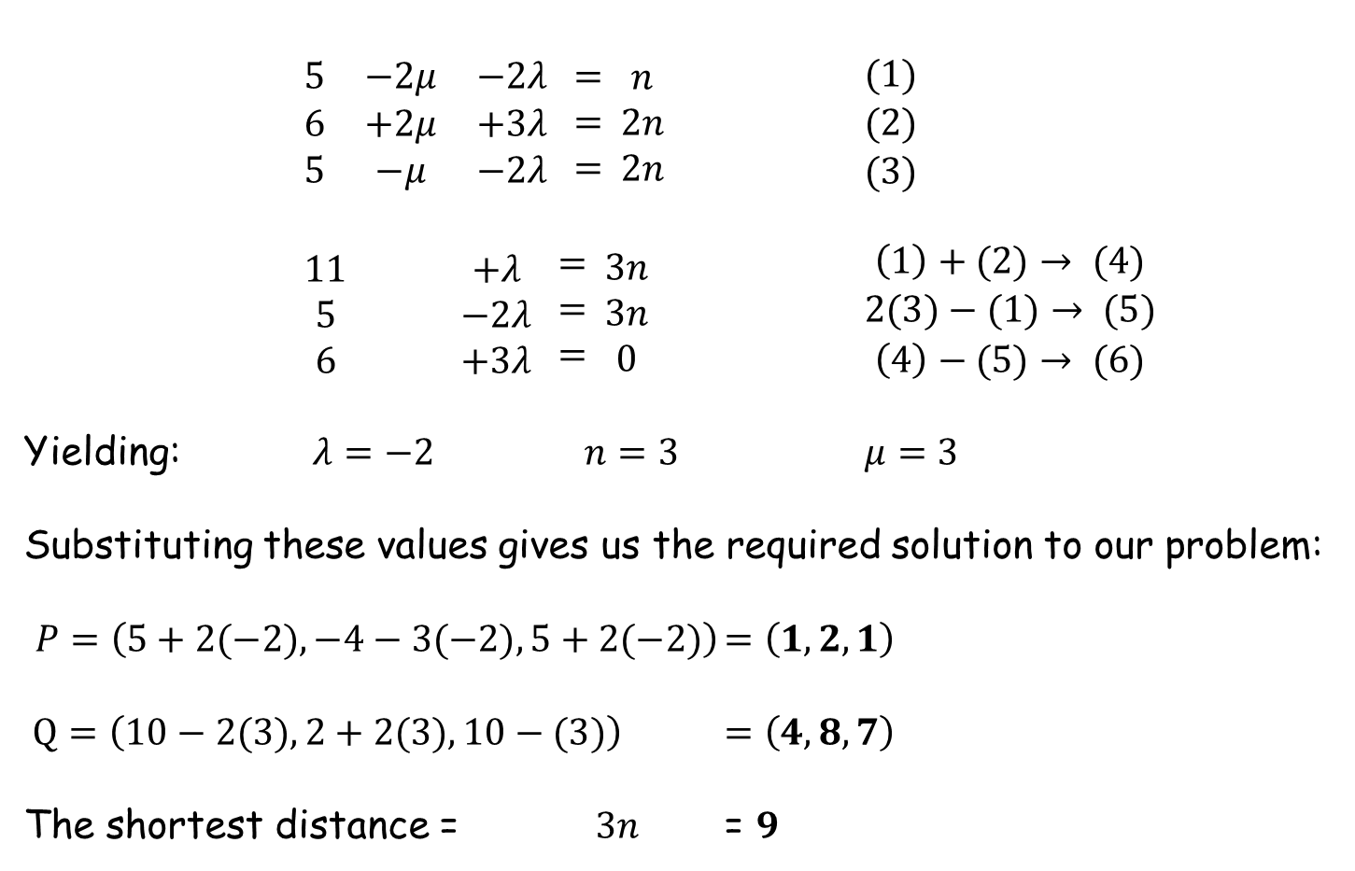
$\begin{matrix}5 & −2μ & −2λ \\ 6 & +2μ & +3λ \\ 5 & −μ & −2λ\end{matrix} \begin{matrix}= \\ = \\ =\end{matrix} \begin{matrix}n \\ 2n \\ 2n\end{matrix}$ $\begin{matrix}(1) \\ (2) \\ (3)\end{matrix}$
$\begin{matrix}11 & & +λ \\ 5 & & −2λ \\ 6 & & +3λ\end{matrix} \begin{matrix}= \\ = \\ =\end{matrix} \begin{matrix}3n \\ 3n \\ 0\end{matrix}$ $\begin{matrix}\left(1\right)+(2)→ (4) \\ 2(3)−(1)→ (5) \\ \left(4\right)−(5)→ (6)\end{matrix}$
Yielding: $λ=−2$ $n=3$ $μ=3$
Substituting these values gives us the required solution to our problem:
$P=\left(5+2(−2), −4−3(−2), 5+2(−2)\right)$ $=\left(1,2,1\right)$
$Q=\left(10−2(3), 2+2(3), 10−(3)\right)$ $=\left(4,8,7\right)$
The shortest distance = $3n$ = $9$

Slide 7
RESOURCES

Slide 8


Skew Lines
The two given lines given are skew (i.e they do not meet).
What is the shortest distance between them?
$$P$$
$$L_{1}=\left(\begin{matrix}5 \\ 0 \\ 1\end{matrix}\right)+λ\left(\begin{matrix}2 \\ −1 \\ 0\end{matrix}\right)$$
$$L_{2}=\left(\begin{matrix}−2 \\ 5 \\ 13\end{matrix}\right)+μ\left(\begin{matrix}2 \\ 1 \\ −2\end{matrix}\right)$$
shortest distance
$$Q$$
Also find the co-ordinates of $P$ and $Q$.
SIC_27

Slide 9

Skew Lines
The two given lines given are skew (i.e they do not meet).
What is the shortest distance between them?
$$P$$
$$L_{1}=\left(\begin{matrix}5 \\ 0 \\ 1\end{matrix}\right)+λ\left(\begin{matrix}2 \\ −1 \\ 0\end{matrix}\right)$$
$$L_{2}=\left(\begin{matrix}−8 \\ 17 \\ 4\end{matrix}\right)+μ\left(\begin{matrix}4 \\ −3 \\ 1\end{matrix}\right)$$
shortest distance
$$Q$$
Also find the co-ordinates of $P$ and $Q$.
SIC_27

Slide 10

Skew Lines
The two given lines given are skew (i.e they do not meet).
What is the shortest distance between them?
$$P$$
$$L_{1}=\left(\begin{matrix}5 \\ 0 \\ 1\end{matrix}\right)+λ\left(\begin{matrix}2 \\ −1 \\ 0\end{matrix}\right)$$
$$L_{2}=\left(\begin{matrix}10 \\ 8 \\ 4\end{matrix}\right)+μ\left(\begin{matrix}−2 \\ 0 \\ 1\end{matrix}\right)$$
shortest distance
$$Q$$
Also find the co-ordinates of $P$ and $Q$.
SIC_27

Slide 11

Skew Lines
The two given lines given are skew (i.e they do not meet).
What is the shortest distance between them?
$$P$$
$$L_{1}=\left(\begin{matrix}5 \\ 0 \\ 1\end{matrix}\right)+λ\left(\begin{matrix}2 \\ −1 \\ 0\end{matrix}\right)$$
$$L_{2}=\left(\begin{matrix}16 \\ 11 \\ −2\end{matrix}\right)+μ\left(\begin{matrix}−4 \\ −1 \\ 3\end{matrix}\right)$$
shortest distance
$$Q$$
Also find the co-ordinates of $P$ and $Q$.
SIC_27

Slide 12

Skew Lines
The two given lines given are skew (i.e they do not meet).
What is the shortest distance between them?
$$P$$
$$L_{1}=\left(\begin{matrix}5 \\ 0 \\ 1\end{matrix}\right)+λ\left(\begin{matrix}2 \\ −1 \\ 0\end{matrix}\right)$$
$$L_{2}=\left(\begin{matrix}4 \\ 23 \\ −8\end{matrix}\right)+μ\left(\begin{matrix}0 \\ −5 \\ 5\end{matrix}\right)$$
shortest distance
$$Q$$
Also find the co-ordinates of $P$ and $Q$.
SIC_27

Slide 13


Skew Lines
The two given lines given are skew (i.e they do not meet).
What is the shortest distance between them?
$$P$$
$$L_{1}=\left(\begin{matrix}5 \\ 4 \\ −3\end{matrix}\right)+λ\left(\begin{matrix}2 \\ 1 \\ −2\end{matrix}\right)$$
$$L_{2}=\left(\begin{matrix}−2 \\ 11 \\ 7\end{matrix}\right)+μ\left(\begin{matrix}2 \\ −1 \\ 0\end{matrix}\right)$$
shortest distance
$$Q$$
Also find the co-ordinates of $P$ and $Q$.
SIC_27

Slide 14
Skew Lines
The two given lines given are skew (i.e they do not meet).
What is the shortest distance between them?
$$P$$
$$L_{1}=\left(\begin{matrix}5 \\ 4 \\ −3\end{matrix}\right)+λ\left(\begin{matrix}2 \\ 1 \\ −2\end{matrix}\right)$$
$$L_{2}=\left(\begin{matrix}−8 \\ 17 \\ 4\end{matrix}\right)+μ\left(\begin{matrix}4 \\ −3 \\ 1\end{matrix}\right)$$
shortest distance
$$Q$$
Also find the co-ordinates of $P$ and $Q$.
SIC_27

Slide 15
Skew Lines
The two given lines given are skew (i.e they do not meet).
What is the shortest distance between them?
$$P$$
$$L_{1}=\left(\begin{matrix}5 \\ 4 \\ −3\end{matrix}\right)+λ\left(\begin{matrix}2 \\ 1 \\ −2\end{matrix}\right)$$
$$L_{2}=\left(\begin{matrix}10 \\ 8 \\ 4\end{matrix}\right)+μ\left(\begin{matrix}−2 \\ 0 \\ 1\end{matrix}\right)$$
shortest distance
$$Q$$
Also find the co-ordinates of $P$ and $Q$.
SIC_27

Slide 16
Skew Lines
The two given lines given are skew (i.e they do not meet).
What is the shortest distance between them?
$$P$$
$$L_{1}=\left(\begin{matrix}5 \\ 4 \\ −3\end{matrix}\right)+λ\left(\begin{matrix}2 \\ 1 \\ −2\end{matrix}\right)$$
$$L_{2}=\left(\begin{matrix}16 \\ 11 \\ −2\end{matrix}\right)+μ\left(\begin{matrix}−4 \\ −1 \\ 3\end{matrix}\right)$$
shortest distance
$$Q$$
Also find the co-ordinates of $P$ and $Q$.
SIC_27

Slide 17
Skew Lines
The two given lines given are skew (i.e they do not meet).
What is the shortest distance between them?
$$P$$
$$L_{1}=\left(\begin{matrix}5 \\ 4 \\ −3\end{matrix}\right)+λ\left(\begin{matrix}2 \\ 1 \\ −2\end{matrix}\right)$$
$$L_{2}=\left(\begin{matrix}4 \\ 23 \\ −8\end{matrix}\right)+μ\left(\begin{matrix}0 \\ −5 \\ 5\end{matrix}\right)$$
shortest distance
$$Q$$
Also find the co-ordinates of $P$ and $Q$.
SIC_27

Slide 18

Skew Lines
The two given lines given are skew (i.e they do not meet).
What is the shortest distance between them?
$$P$$
$$L_{1}=\left(\begin{matrix}9 \\ −4 \\ 3\end{matrix}\right)+λ\left(\begin{matrix}4 \\ −3 \\ 1\end{matrix}\right)$$
$$L_{2}=\left(\begin{matrix}−2 \\ 11 \\ 7\end{matrix}\right)+μ\left(\begin{matrix}2 \\ −1 \\ 0\end{matrix}\right)$$
shortest distance
$$Q$$
Also find the co-ordinates of $P$ and $Q$.
SIC_27

Slide 19
Skew Lines
The two given lines given are skew (i.e they do not meet).
What is the shortest distance between them?
$$P$$
$$L_{1}=\left(\begin{matrix}9 \\ −4 \\ 3\end{matrix}\right)+λ\left(\begin{matrix}4 \\ −3 \\ 1\end{matrix}\right)$$
$$L_{2}=\left(\begin{matrix}−2 \\ 5 \\ 13\end{matrix}\right)+μ\left(\begin{matrix}2 \\ 1 \\ −2\end{matrix}\right)$$
shortest distance
$$Q$$
Also find the co-ordinates of $P$ and $Q$.
SIC_27

Slide 20
Skew Lines
The two given lines given are skew (i.e they do not meet).
What is the shortest distance between them?
$$P$$
$$L_{1}=\left(\begin{matrix}9 \\ −4 \\ 3\end{matrix}\right)+λ\left(\begin{matrix}4 \\ −3 \\ 1\end{matrix}\right)$$
$$L_{2}=\left(\begin{matrix}10 \\ 8 \\ 4\end{matrix}\right)+μ\left(\begin{matrix}−2 \\ 0 \\ 1\end{matrix}\right)$$
shortest distance
$$Q$$
Also find the co-ordinates of $P$ and $Q$.
SIC_27

Slide 21
Skew Lines
The two given lines given are skew (i.e they do not meet).
What is the shortest distance between them?
$$P$$
$$L_{1}=\left(\begin{matrix}9 \\ −4 \\ 3\end{matrix}\right)+λ\left(\begin{matrix}4 \\ −3 \\ 1\end{matrix}\right)$$
$$L_{2}=\left(\begin{matrix}16 \\ 11 \\ −2\end{matrix}\right)+μ\left(\begin{matrix}−4 \\ −1 \\ 3\end{matrix}\right)$$
shortest distance
$$Q$$
Also find the co-ordinates of $P$ and $Q$.
SIC_27

Slide 22
Skew Lines
The two given lines given are skew (i.e they do not meet).
What is the shortest distance between them?
$$P$$
$$L_{1}=\left(\begin{matrix}9 \\ −4 \\ 3\end{matrix}\right)+λ\left(\begin{matrix}4 \\ −3 \\ 1\end{matrix}\right)$$
$$L_{2}=\left(\begin{matrix}4 \\ 23 \\ −8\end{matrix}\right)+μ\left(\begin{matrix}0 \\ −5 \\ 5\end{matrix}\right)$$
shortest distance
$$Q$$
Also find the co-ordinates of $P$ and $Q$.
SIC_27

Slide 23

Skew Lines
The two given lines given are skew (i.e they do not meet).
What is the shortest distance between them?
$$P$$
$$L_{1}=\left(\begin{matrix}−7 \\ 0 \\ 7\end{matrix}\right)+λ\left(\begin{matrix}−4 \\ −1 \\ 3\end{matrix}\right)$$
$$L_{2}=\left(\begin{matrix}−2 \\ 11 \\ 7\end{matrix}\right)+μ\left(\begin{matrix}2 \\ −1 \\ 0\end{matrix}\right)$$
shortest distance
$$Q$$
Also find the co-ordinates of $P$ and $Q$.
SIC_27

Slide 24
Skew Lines
The two given lines given are skew (i.e they do not meet).
What is the shortest distance between them?
$$P$$
$$L_{1}=\left(\begin{matrix}−7 \\ 0 \\ 7\end{matrix}\right)+λ\left(\begin{matrix}−4 \\ −1 \\ 3\end{matrix}\right)$$
$$L_{2}=\left(\begin{matrix}−2 \\ 5 \\ 13\end{matrix}\right)+μ\left(\begin{matrix}2 \\ 1 \\ −2\end{matrix}\right)$$
shortest distance
$$Q$$
Also find the co-ordinates of $P$ and $Q$.
SIC_27

Slide 25
Skew Lines
The two given lines given are skew (i.e they do not meet).
What is the shortest distance between them?
$$P$$
$$L_{1}=\left(\begin{matrix}−7 \\ 0 \\ 7\end{matrix}\right)+λ\left(\begin{matrix}−4 \\ −1 \\ 3\end{matrix}\right)$$
$$L_{2}=\left(\begin{matrix}10 \\ 8 \\ 4\end{matrix}\right)+μ\left(\begin{matrix}−2 \\ 0 \\ 1\end{matrix}\right)$$
shortest distance
$$Q$$
Also find the co-ordinates of $P$ and $Q$.
SIC_27

Slide 26
Skew Lines
The two given lines given are skew (i.e they do not meet).
What is the shortest distance between them?
$$P$$
$$L_{1}=\left(\begin{matrix}−7 \\ 0 \\ 7\end{matrix}\right)+λ\left(\begin{matrix}−4 \\ −1 \\ 3\end{matrix}\right)$$
$$L_{2}=\left(\begin{matrix}−8 \\ 17 \\ 4\end{matrix}\right)+μ\left(\begin{matrix}4 \\ −3 \\ 1\end{matrix}\right)$$
shortest distance
$$Q$$
Also find the co-ordinates of $P$ and $Q$.
SIC_27

Slide 27
Skew Lines
The two given lines given are skew (i.e they do not meet).
What is the shortest distance between them?
$$P$$
$$L_{1}=\left(\begin{matrix}−7 \\ 0 \\ 7\end{matrix}\right)+λ\left(\begin{matrix}−4 \\ −1 \\ 3\end{matrix}\right)$$
$$L_{2}=\left(\begin{matrix}4 \\ 23 \\ −8\end{matrix}\right)+μ\left(\begin{matrix}0 \\ −5 \\ 5\end{matrix}\right)$$
shortest distance
$$Q$$
Also find the co-ordinates of $P$ and $Q$.
SIC_27

