Slide 1
Sea Shell Product

Slide 2
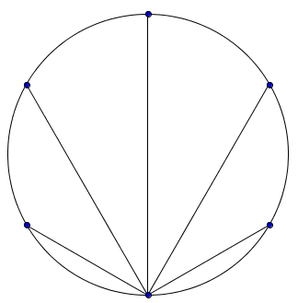
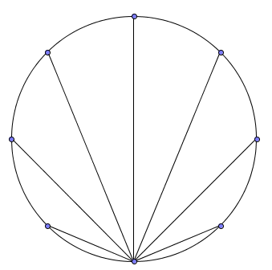
Sea Shell Product
Each circle is a unit circle (i.e. radius = 1) with dots equally spaced on the circumference.
Find the product of the lengths of the chords drawn in each circle.
Notes:
6,8

Slide 3
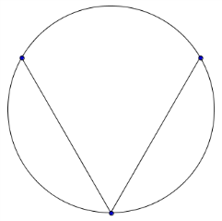
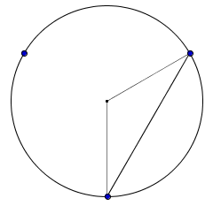
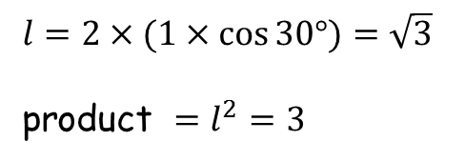

Sea Shell Product
3
$$\frac{360}{3}=120°$$
$$1$$
$$l$$
$l=2×(1×\cos{30°})=\sqrt{3}$
product $=l^{2}=3$
$$1$$
$$30°$$

Slide 4
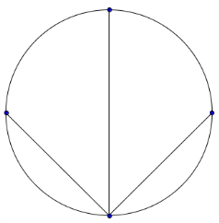
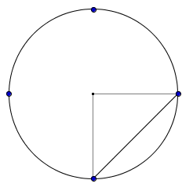
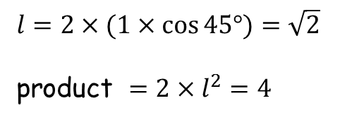

Sea Shell Product
4
$$\frac{360}{4}=90°$$
$$1$$
$l=2×(1×\cos{45°})=\sqrt{2}$
product $=2×l^{2}=4$
$$1$$
$$l$$
$$45°$$

Slide 5
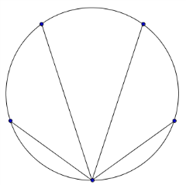
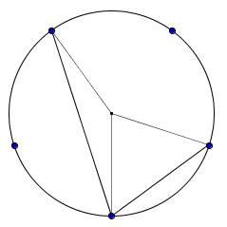
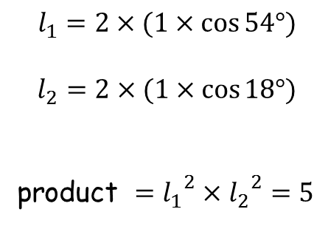

Sea Shell Product
5
$$144°$$
$$\frac{360}{5}=72°$$
$$l_{1}=2×(1×\cos{54°})$$
$$l_{2}=2×(1×\cos{18°})$$
product $={l_{1}}^{2}×{l_{2}}^{2}=5$
$$l_{2}$$
$$18°$$
$$l_{1}$$
$$54°$$

Slide 6
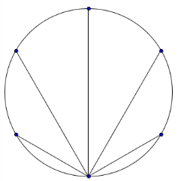
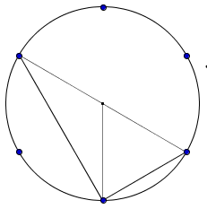
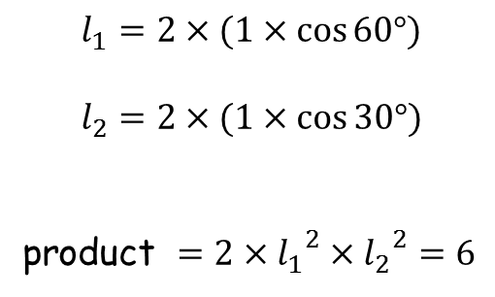

Sea Shell Product
6
$$120°$$
$$\frac{360}{6}=60°$$
$$l_{1}=2×(1×\cos{60°})$$
$$l_{2}=2×(1×\cos{30°})$$
product $=2×{l_{1}}^{2}×{l_{2}}^{2}=6$
$$l_{2}$$
$$l_{1}$$
$$30°$$
$$60°$$

Slide 7
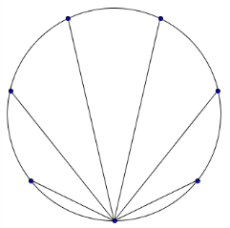
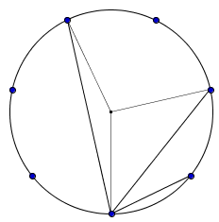
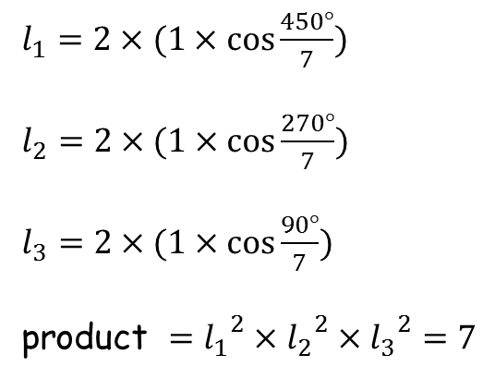
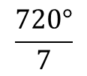

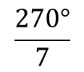
Sea Shell Product
7
$l_{1}=2×(1×\cos{\frac{450°}{7}})$
$l_{2}=2×(1×\cos{\frac{270°}{7}})$
$l_{3}=2×(1×\cos{\frac{90°}{7}})$
product $={l_{1}}^{2}×{l_{2}}^{2}×{l_{3}}^{2}=7$
$$\frac{1080°}{7}$$
$$\frac{720°}{7}$$
$$l_{3}$$
$$l_{2}$$
$$\frac{90°}{7}$$
$$l_{1}$$
$$\frac{270°}{7}$$

Slide 8
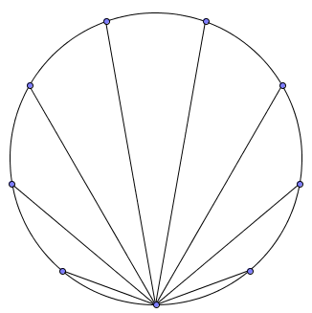
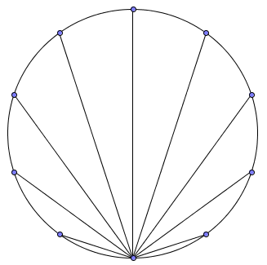
Sea Shell Product
product $=2{\left(2\cos{\frac{135}{2}}\right)}^{2}{\left(2\cos{\frac{90}{2}}\right)}^{2}{\left(2\cos{\frac{45}{2}}\right)}^{2}=8$
8
product $={\left(2\cos{70}\right)}^{2}{\left(2\cos{50}\right)}^{2}{\left(2\cos{30}\right)}^{2}{\left(2\cos{10}\right)}^{2}=9$
9
product $={2\left(2\cos{72}\right)}^{2}{\left(2\cos{54}\right)}^{2}{\left(2\cos{36}\right)}^{2}{\left(2\cos{18}\right)}^{2}=10$
10

Slide 9
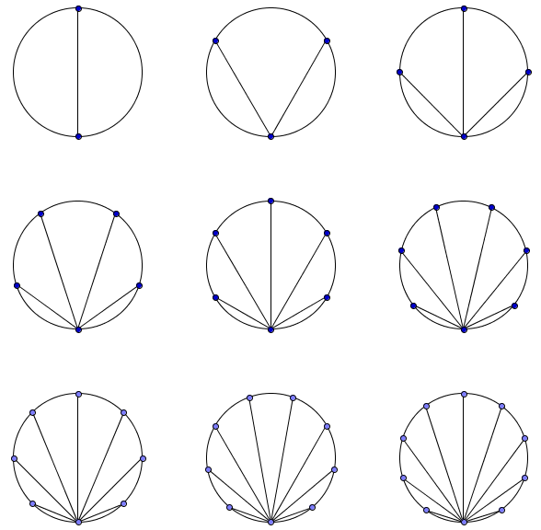
Sea Shell Product
Results
2
3
4
5
6
7
8
9
10

Slide 11
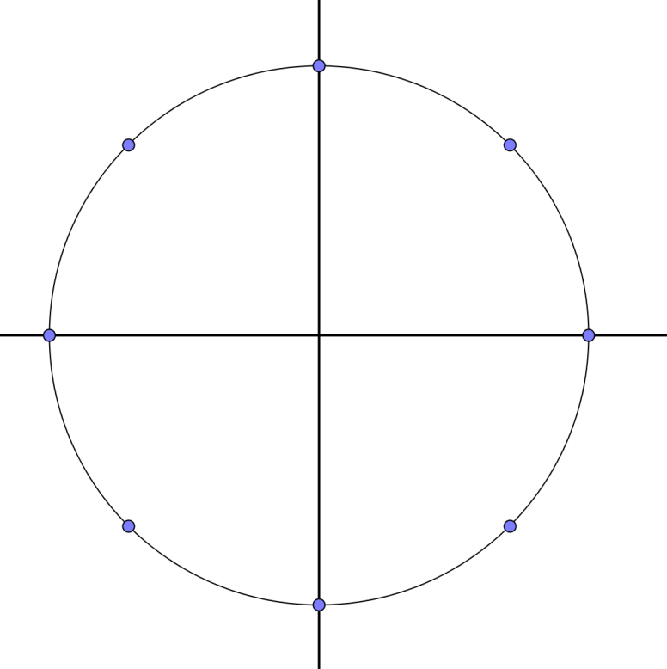
Sea Shell Product
A Proof
$$w_{2}$$
$$…$$
$$w_{1}$$
Let the points represent the $n^{th}$ roots of $1$.
$w_{i}$ represents a complex number.
Let’s translate the unit circle $\left(\begin{matrix}−1 \\ 0\end{matrix}\right)$ .
$$w_{0}$$
$$w_{n−1}$$
$$…$$

Slide 12
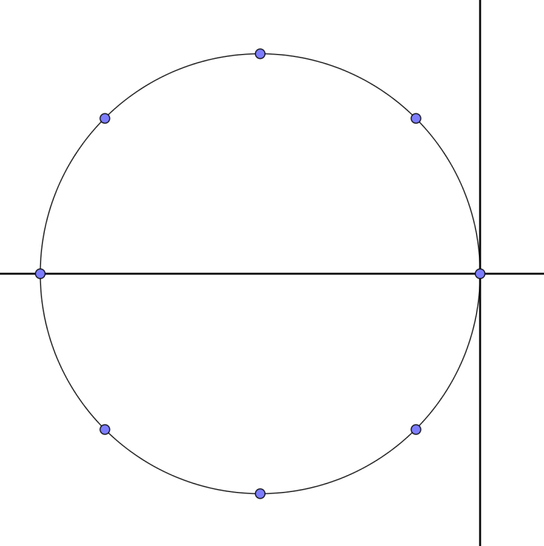
Sea Shell Product
$$w_{2}−1$$
$$…$$
$$w_{1}−1$$
Let the points represent the $n^{th}$ roots of $1$.
$w_{i}$ represents a complex number.
Let’s translate the unit circle $\left(\begin{matrix}−1 \\ 0\end{matrix}\right)$ .
$$w_{0}−1$$
$$w_{n−1}−1$$
$$…$$

Slide 13
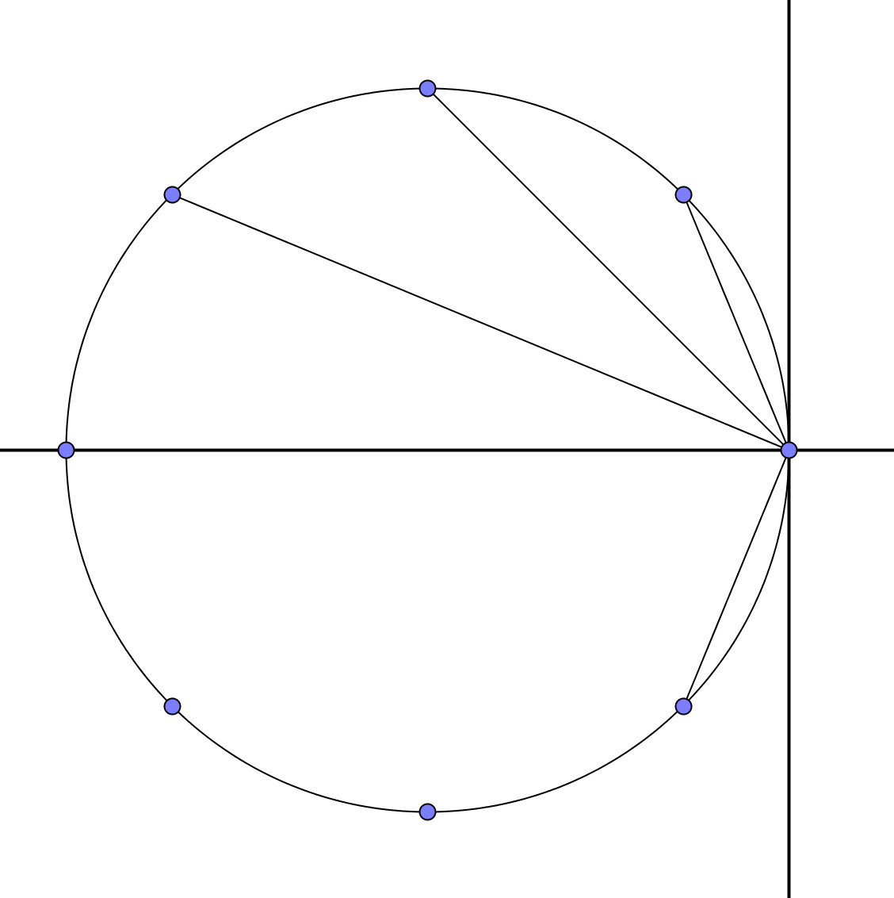
Sea Shell Product
$$w_{2}−1$$
$$…$$
$$w_{1}−1$$
$$w_{0}−1$$
$$w_{n−1}−1$$
$$…$$
The product of the lengths we require is now equivalent to finding the product:
$$\left|\left(w_{1}−1\right)\right|×\left|\left(w_{2}−1\right)\right|×\left|\left(w_{3}−1\right)\right|×…×\left|\left(w_{n−1}−1\right)\right|$$
All $w_{i}$ satisfy $z^{n}−1=0$ where $z$ is a complex number.
So $\left(z−w_{i}\right)$ are all factors of $z^{n}−1$ (factor theorem).

Slide 14
Sea Shell Product
The product of the lengths we require is now equivalent to finding the product:
$$\left|\left(w_{1}−1\right)\right|×\left|\left(w_{2}−1\right)\right|×\left|\left(w_{3}−1\right)\right|×…×\left|\left(w_{n−1}−1\right)\right|$$
All $w_{i}$ satisfy $z^{n}−1=0$ where $z$ is a complex number.
So $\left(z−w_{i}\right)$ are all factors of $z^{n}−1$ (factor theorem).
$z^{n}−1=\left(z−w_{0}\right)\left(z−w_{1}\right)\left(z−w_{2}\right)…\left(z−w_{n−1}\right)$
$=\left(z−1\right)\left(z−w_{1}\right)\left(z−w_{2}\right)…\left(z−w_{n−1}\right)$
$\frac{z^{n}−1}{z−1}=\left(z−w_{1}\right)\left(z−w_{2}\right)…\left(z−w_{n−1}\right)$ (1)
Now, by polynomial division
$z^{n}−1=\left(z−1\right)\left(z^{n−1}+z^{n−2}+z^{n−3}+…+1\right)$
$\frac{z^{n}−1}{z−1}=z^{n−1}+z^{n−2}+z^{n−3}+…+1$ (2)

Slide 15

Sea Shell Product
$\frac{z^{n}−1}{z−1}=\left(z−w_{1}\right)\left(z−w_{2}\right)…\left(z−w_{n−1}\right)$ (1)
$\frac{z^{n}−1}{z−1}=z^{n−1}+z^{n−2}+z^{n−3}+…+1$ (2)
Equating (1) and (2) gives:
$z^{n−1}+z^{n−2}+z^{n−3}+…+1=\left(z−w_{1}\right)\left(z−w_{2}\right)…\left(z−w_{n−1}\right)$
Let $z=1$
$n=\left(1−w_{1}\right)\left(1−w_{2}\right)…\left(1−w_{n−1}\right)$
Noting that
$\prod{\left|z_{i}\right|}=\left|\prod{z_{i}}\right|$
$n=\left(w_{1}−1\right)\left(w_{2}−1\right)\left(w_{3}−1\right)…\left(w_{n−1}−1\right)$ , as required.

Slide 17
RESOURCES

Slide 18
Sea Shell Product
SIC_44
Each circle is a unit circle (i.e. radius = 1) with dots equally spaced on the circumference.
Find the product of the lengths of the chords drawn in each circle.
Notes:
6,8

Slide 19
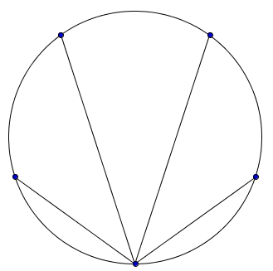
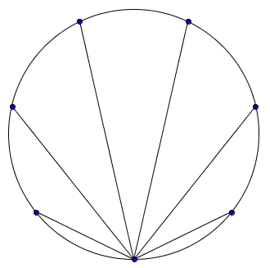
Sea Shell Product
SIC_44
Each circle is a unit circle (i.e. radius = 1) with dots equally spaced on the circumference.
Find the product of the lengths of the chords drawn in each circle.
Notes:
5,7

Slide 20
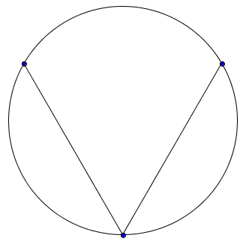
Sea Shell Product
SIC_44
Each circle is a unit circle (i.e. radius = 1) with dots equally spaced on the circumference.
Find the product of the lengths of the chords drawn in each circle.
Notes:
3,10

Slide 21
Sea Shell Product
SIC_44
Each circle is a unit circle (i.e. radius = 1) with dots equally spaced on the circumference.
Find the product of the lengths of the chords drawn in each circle.
Notes:
6,7

Slide 22
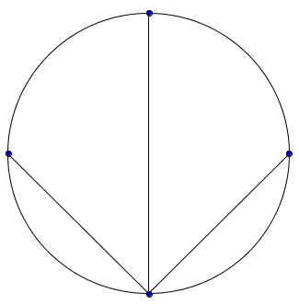
Sea Shell Product
SIC_44
Each circle is a unit circle (i.e. radius = 1) with dots equally spaced on the circumference.
Find the product of the lengths of the chords drawn in each circle.
Notes:
4,9

Slide 23
Sea Shell Product
SIC_44
Each circle is a unit circle (i.e. radius = 1) with dots equally spaced on the circumference.
Find the product of the lengths of the chords drawn in each circle.
Notes:
5,8

Slide 25
