Slide 1
Integration Stretch
Notes:
Answer: k=3 for all problems!
Pupils need to work out the equation of the starting parabola (easy).
Then define a stretch factor, k, say and find where the two parabolas intersect.
Integrate to get the area between the parabolas and equate this to the area given to determine the stretch factor.
Print 4 to a page and cut up to give individual challenges to each pupil.

Slide 2
Note to teacher
Pupils can get bogged down with the algebra so you can use the spreadsheet to show some of the steps that their working should include.
Update the yellow cells with their parameters.

Slide 3
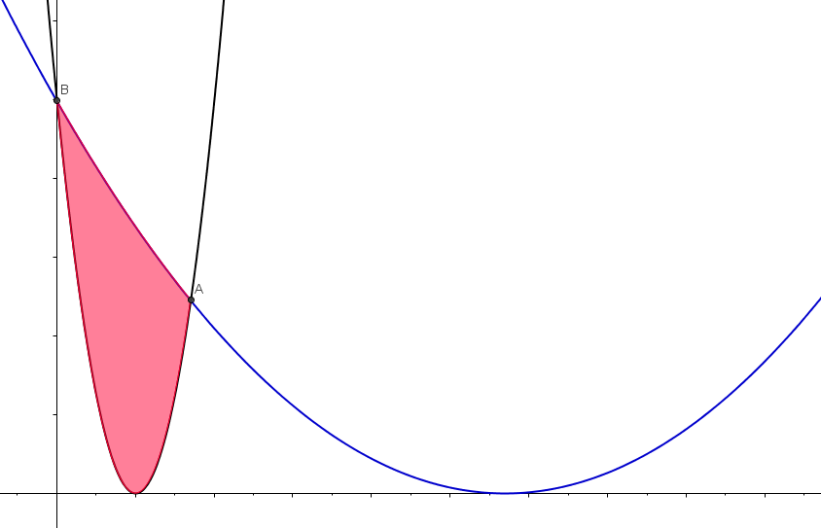
y
NOT TO SCALE
f (x), a parabola
16
What stretch factor, k, gives the area stated?
32
g(x) ,
defined by a stretch, parallel to x-axis, of f (x)
0
4
x

Slide 4
General Solution
Find the $x$-coordinate of point A:
Let $\left(a,0\right)$ be the coordinates for the minimum point of the originating parabola and $h$ and $k$ be the stretch factors in the $y−$ and $x−$ directions, respectively.
Solve: ${h\left(x−a\right)}^{2}={h\left(\frac{x}{k}−a\right)}^{2}$
$x^{2}−2ax+a^{2}={\left(\frac{x}{k}\right)}^{2}−2\left(\frac{a}{k}\right)x+a^{2}$
$\left(1−{\left(\frac{1}{k}\right)}^{2}\right)x^{2}−2a\left(1−\left(\frac{1}{k}\right)\right)x=0$
$\left(\frac{k^{2}−1}{k^{2}}\right)x=2a\left(\frac{k−1}{k}\right)$ (ignoring $x=0$)
$x=2a\left(\frac{k−1}{k}\right)\left(\frac{k^{2}}{k^{2}−1}\right)$
So, $x=2a\left(\frac{k}{k+1}\right)$ and $x=0$ are the $x$- coordinates of A and B, respectively.

Slide 5
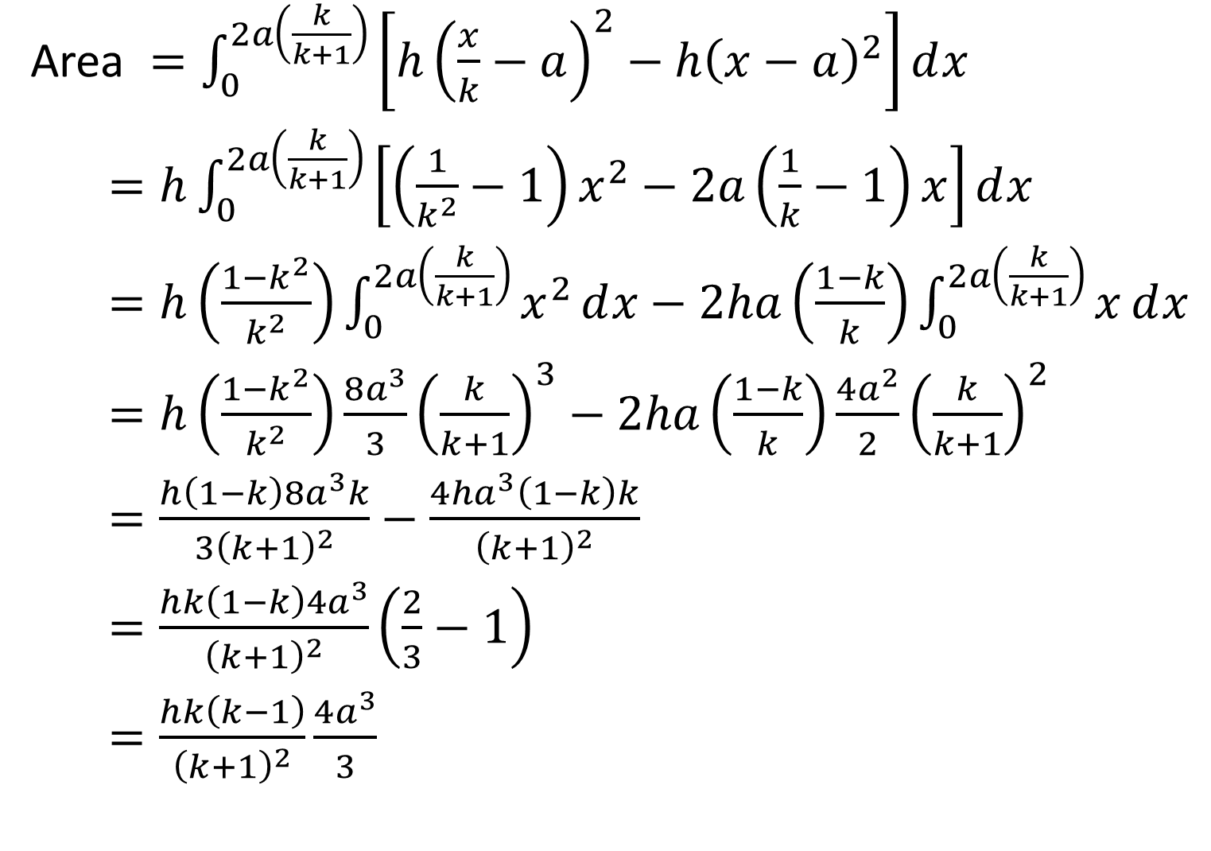
Area $=\int_{0}^{2a\left(\frac{k}{k+1}\right)}{\left[h{\left(\frac{x}{k}−a\right)}^{2}−h{\left(x−a\right)}^{2}\right]ⅆx}$
$=h\int_{0}^{2a\left(\frac{k}{k+1}\right)}{\left[\left(\frac{1}{k^{2}}−1\right)x^{2}−2a\left(\frac{1}{k}−1\right)x\right]ⅆx}$
$=h\left(\frac{1−k^{2}}{k^{2}}\right)\int_{0}^{2a\left(\frac{k}{k+1}\right)}{x^{2}ⅆx}−2ha\left(\frac{1−k}{k}\right)\int_{0}^{2a\left(\frac{k}{k+1}\right)}{xⅆx}$
$=h\left(\frac{1−k^{2}}{k^{2}}\right)\frac{8a^{3}}{3}{\left(\frac{k}{k+1}\right)}^{3}−2ha\left(\frac{1−k}{k}\right)\frac{4a^{2}}{2}{\left(\frac{k}{k+1}\right)}^{2}$
$=\frac{h\left(1−k\right)8a^{3}k}{3{\left(k+1\right)}^{2}}−\frac{4ha^{3}\left(1−k\right)k}{{\left(k+1\right)}^{2}}$
$=\frac{hk\left(1−k\right)4a^{3}}{{\left(k+1\right)}^{2}}\left(\frac{2}{3}−1\right)$
$=\frac{hk\left(k−1\right)}{{\left(k+1\right)}^{2}}\frac{{4a}^{3}}{3}$

Slide 6
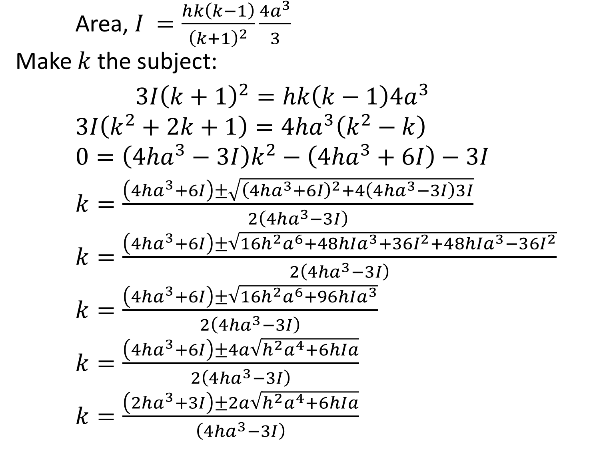
Area, $I$ $=\frac{hk\left(k−1\right)}{{\left(k+1\right)}^{2}}\frac{{4a}^{3}}{3}$
Make $k$ the subject:
$3I{\left(k+1\right)}^{2}=hk\left(k−1\right)4a^{3}$
$3I\left(k^{2}+2k+1\right)=4ha^{3}\left(k^{2}−k\right)$
$0=\left(4ha^{3}−3I\right)k^{2}−\left(4ha^{3}+6I\right)−3I$
$k=\frac{\left(4ha^{3}+6I\right)±\sqrt{{\left(4ha^{3}+6I\right)}^{2}+4\left(4ha^{3}−3I\right)3I}}{2\left(4ha^{3}−3I\right)}$
$k=\frac{\left(4ha^{3}+6I\right)±\sqrt{16h^{2}a^{6}+48hIa^{3}+36I^{2}+48hIa^{3}−36I^{2}}}{2\left(4ha^{3}−3I\right)}$
$k=\frac{\left(4ha^{3}+6I\right)±\sqrt{16h^{2}a^{6}+96hIa^{3}}}{2\left(4ha^{3}−3I\right)}$
$k=\frac{\left(4ha^{3}+6I\right)±4a\sqrt{{h^{2}a}^{4}+6hIa}}{2\left(4ha^{3}−3I\right)}$
$k=\frac{\left(2ha^{3}+3I\right)±2a\sqrt{{h^{2}a}^{4}+6hIa}}{\left(4ha^{3}−3I\right)}$

Slide 7
$$0=\left(4ha^{3}−3I\right)k^{2}−\left(4ha^{3}+6I\right)−3I$$
All of your situations boil down to:
5$k^{2}−14k−3=0$
$\left(5k+1\right)\left(k−3\right)=0$
$k=3$ and $k=−\frac{1}{5}$
How can you explain the negative value? In that case $f(x)$ is above $g(x)$ but you don’t get a negative answer.
(Hint: look at the limits)

Slide 8
Resources

Slide 9
y
NOT TO SCALE
f (x), a parabola
16
What stretch factor, k, gives the area stated?
32
g(x) ,
defined by a stretch, parallel to x-axis, of f (x)
0
4
x
SIC_14

Slide 10
y
NOT TO SCALE
f (x), a parabola
4
What stretch factor, k, gives the area stated?
4
g(x) ,
defined by a stretch, parallel to x-axis, of f (x)
0
2
x
SIC_14

Slide 11
y
NOT TO SCALE
f (x), a parabola
36
What stretch factor, k, gives the area stated?
108
g(x) ,
defined by a stretch, parallel to x-axis, of f (x)
0
6
x
SIC_14

Slide 12
y
NOT TO SCALE
f (x), a parabola
20
What stretch factor, k, gives the area stated?
20
g(x) ,
defined by a stretch, parallel to x-axis, of f (x)
0
2
x
SIC_14

Slide 13
y
NOT TO SCALE
f (x), a parabola
4
What stretch factor, k, gives the area stated?
8
g(x) ,
defined by a stretch, parallel to x-axis, of f (x)
0
4
x
SIC_14

Slide 14
y
NOT TO SCALE
f (x), a parabola
8
What stretch factor, k, gives the area stated?
8
g(x) ,
defined by a stretch, parallel to x-axis, of f (x)
0
2
x
SIC_14

Slide 15
y
NOT TO SCALE
f (x), a parabola
6
What stretch factor, k, gives the area stated?
18
g(x) ,
defined by a stretch, parallel to x-axis, of f (x)
0
6
x
SIC_14

Slide 16
y
NOT TO SCALE
f (x), a parabola
2
What stretch factor, k, gives the area stated?
2
g(x) ,
defined by a stretch, parallel to x-axis, of f (x)
0
2
x
SIC_14

Slide 17
y
NOT TO SCALE
f (x), a parabola
8
What stretch factor, k, gives the area stated?
16
g(x) ,
defined by a stretch, parallel to x-axis, of f (x)
0
4
x
SIC_14

Slide 18
y
NOT TO SCALE
f (x), a parabola
12
What stretch factor, k, gives the area stated?
12
g(x) ,
defined by a stretch, parallel to x-axis, of f (x)
0
2
x
SIC_14

Slide 19
y
NOT TO SCALE
f (x), a parabola
3
What stretch factor, k, gives the area stated?
9
g(x) ,
defined by a stretch, parallel to x-axis, of f (x)
0
6
x
SIC_14

Slide 20
y
NOT TO SCALE
f (x), a parabola
1
What stretch factor, k, gives the area stated?
1
g(x) ,
defined by a stretch, parallel to x-axis, of f (x)
0
2
x
SIC_14

Slide 21
y
NOT TO SCALE
f (x), a parabola
32
What stretch factor, k, gives the area stated?
64
g(x) ,
defined by a stretch, parallel to x-axis, of f (x)
0
4
x
SIC_14

Slide 22
y
NOT TO SCALE
f (x), a parabola
16
What stretch factor, k, gives the area stated?
16
g(x) ,
defined by a stretch, parallel to x-axis, of f (x)
0
2
x
SIC_14

Slide 23
y
NOT TO SCALE
f (x), a parabola
1
What stretch factor, k, gives the area stated?
3
g(x) ,
defined by a stretch, parallel to x-axis, of f (x)
0
6
x
SIC_14

Slide 24
y
NOT TO SCALE
f (x), a parabola
6
What stretch factor, k, gives the area stated?
6
g(x) ,
defined by a stretch, parallel to x-axis, of f (x)
0
2
x
SIC_14

Slide 25
$$0=\left(4ha^{3}−3I\right)k^{2}−\left(4ha^{3}+6I\right)−3I$$
Let $I^{′}=\frac{I}{h}$ (this ratio is constant for each value of $a$ used).
$$0=\left(4a^{3}−3I^{′}\right)k^{2}−\left(4a^{3}+6I^{′}\right)−3I^{′}$$
All of the problems given boil down to:
You should have achieved one of these quadratics:
For $a=2$ , $I^{′}=4$ $20k^{2}−56k−12=0$
For $a=4$ , $I^{′}=32$ $160k^{2}−448k−96=0$
For $a=6$ , $I^{′}=108$ $540k^{2}−1512k−324=0$
Which all simplify to: 5$k^{2}−14k−3=0$
$\left(5k+1\right)\left(k−3\right)=0$
$k=3$ and $k=−\frac{1}{5}$

