Slide 1
How Many Sides?
From an article in
Mathematics Teaching 210
by Paul Stephenson
Notes:
Source: MT210 September 2008 p48 Paul Stephenson www.atm.org.uk/mt210

Slide 2
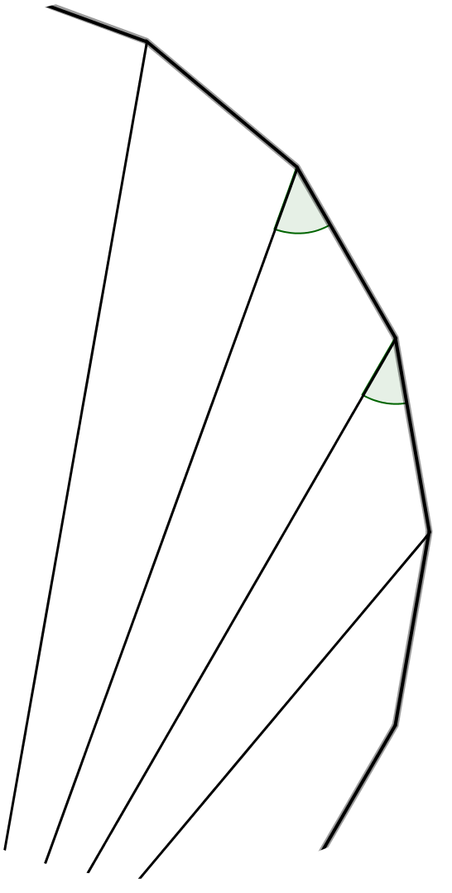
How Many Sides?
(Not to scale)
The diagram shows part of a regular polygon and part of some diagonals of the polygon drawn from one vertex. Two angles are marked.
How many sides has the polygon?
$$20°$$
$$15°$$

Slide 3
How Many Sides?
A polygon with $n$ sides
(often called an n-gon)

Slide 4
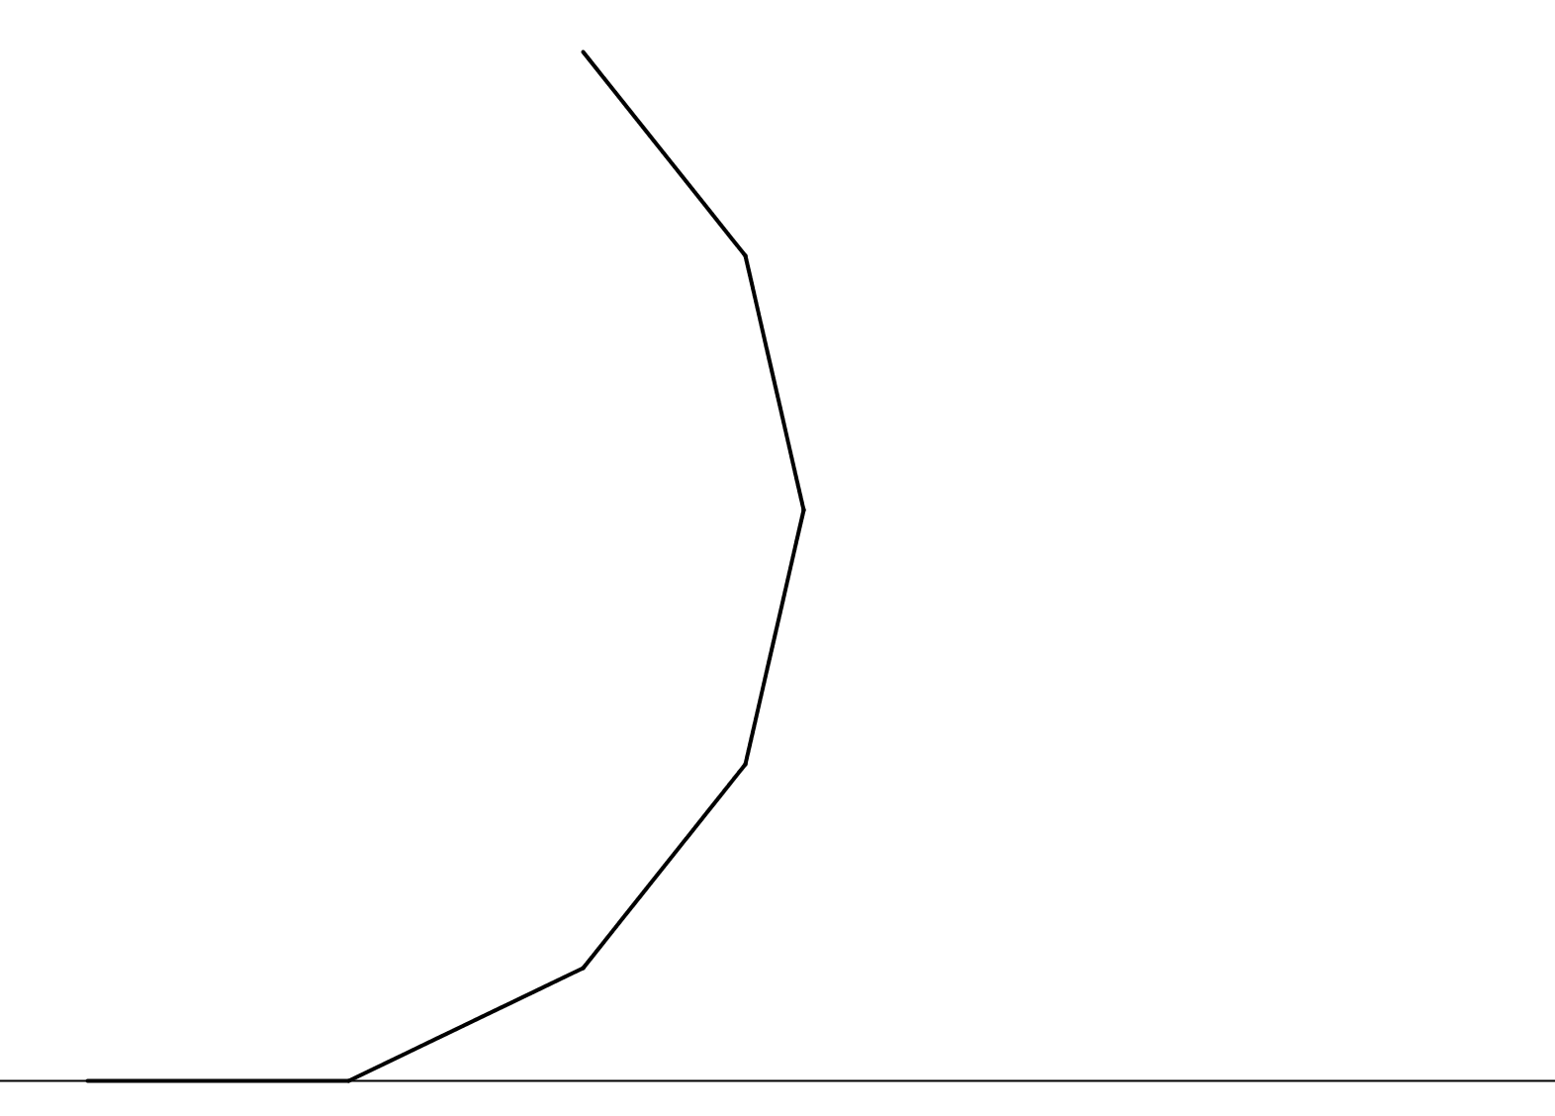
How Many Sides?
the external angle $\left(=\frac{360°}{n}\right)$
$$α$$

Slide 5
How Many Sides?
first diagonal
$$\frac{1}{2}α$$
$$α$$

Slide 6
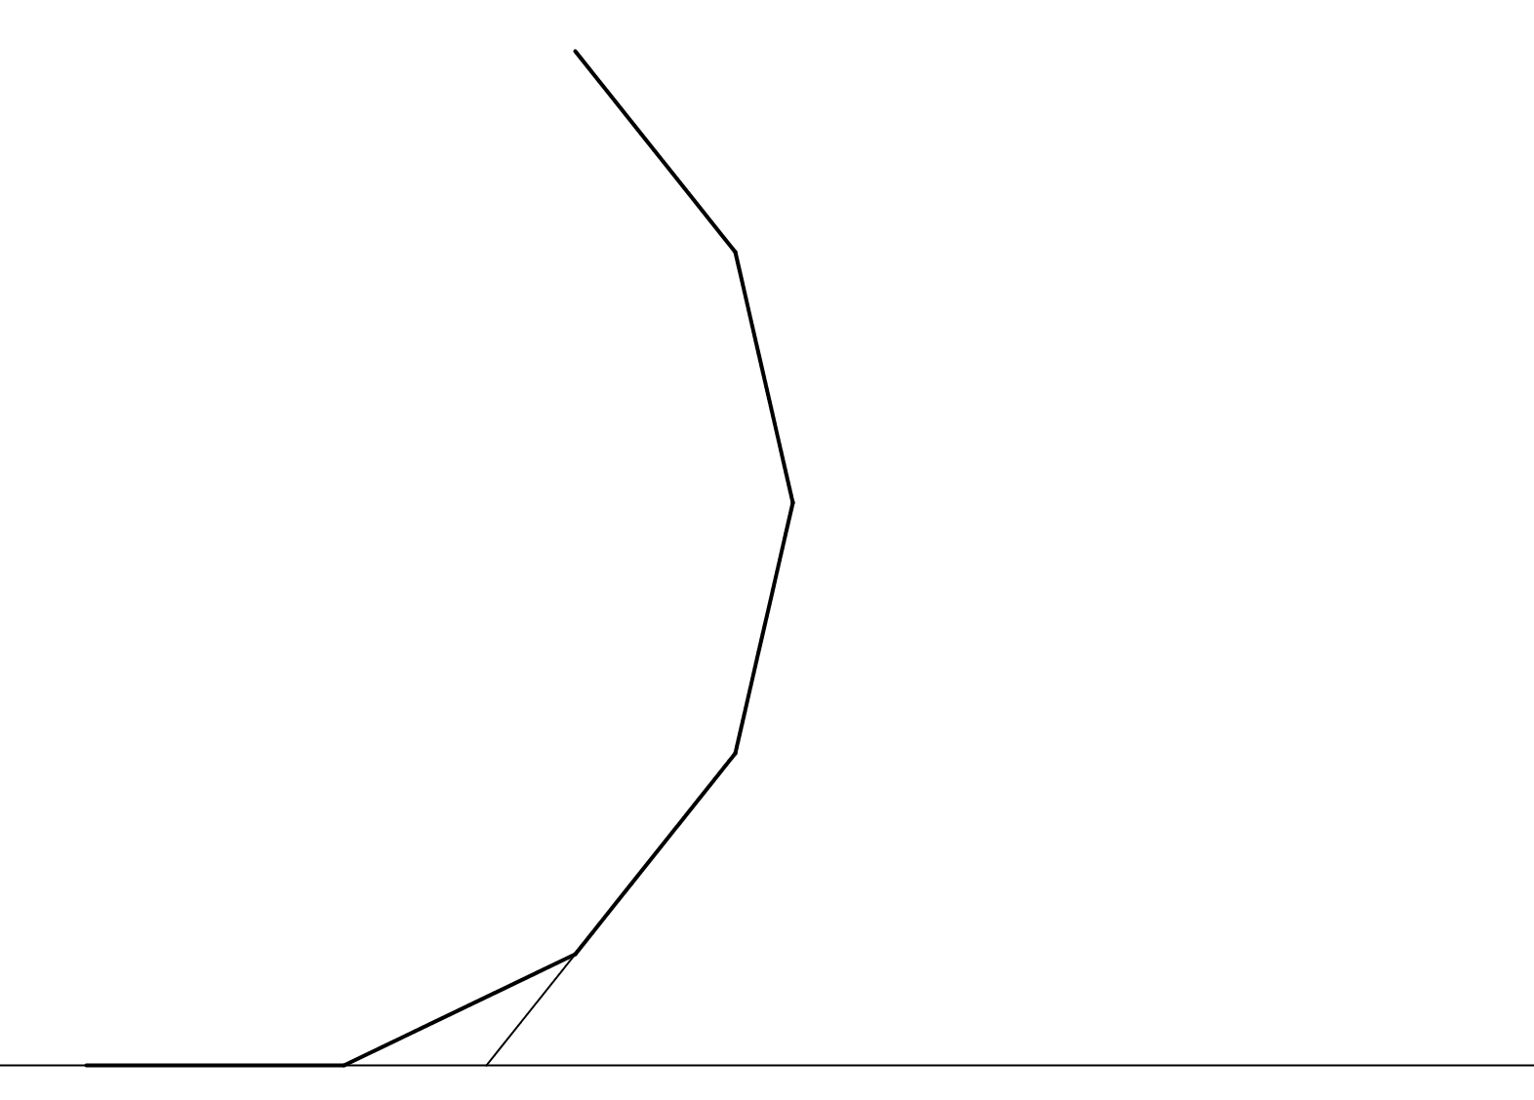
How Many Sides?
$$α$$
$$α$$
$$2α$$

Slide 7
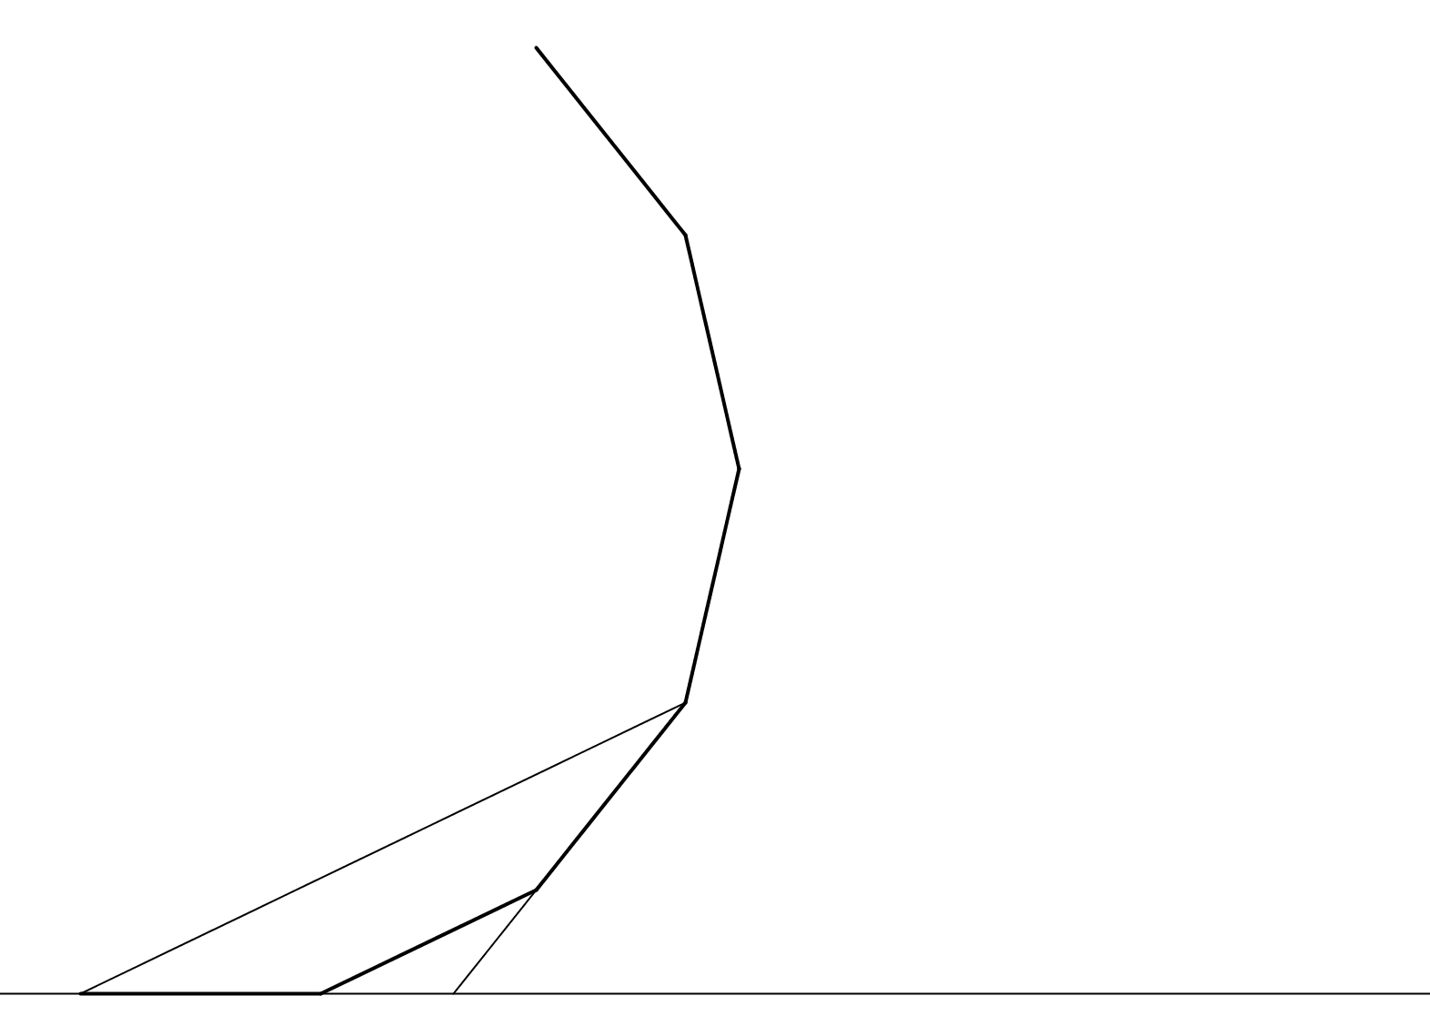
How Many Sides?
second diagonal
$$α$$
$$α$$
$$2α$$

Slide 8
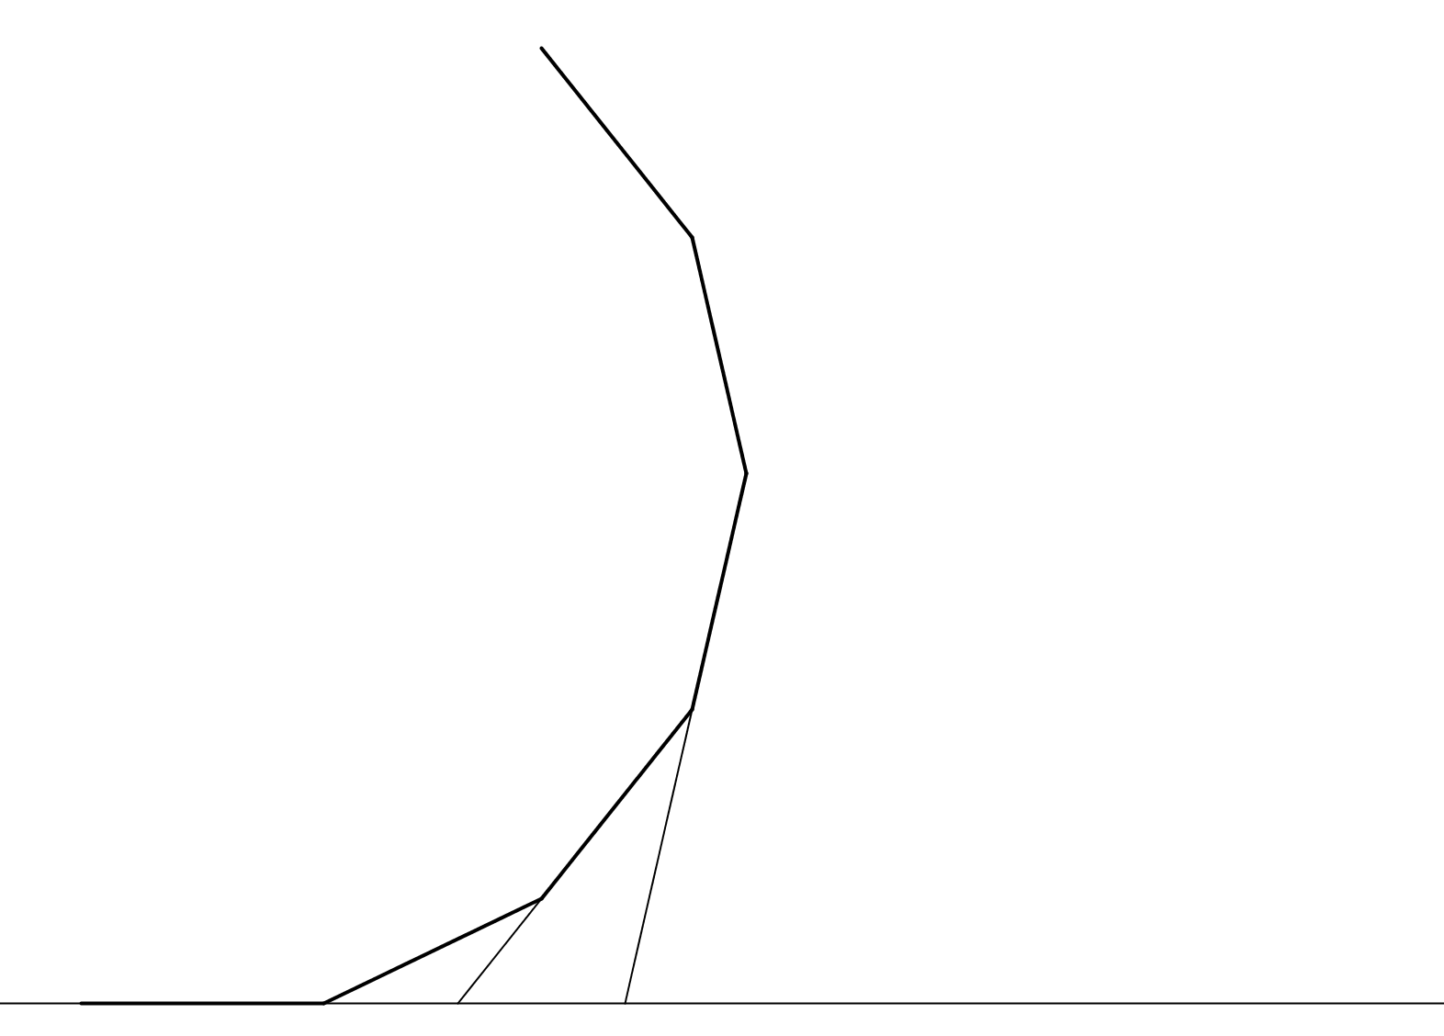
How Many Sides?
$$α$$
$$2α$$
$$3α$$

Slide 9
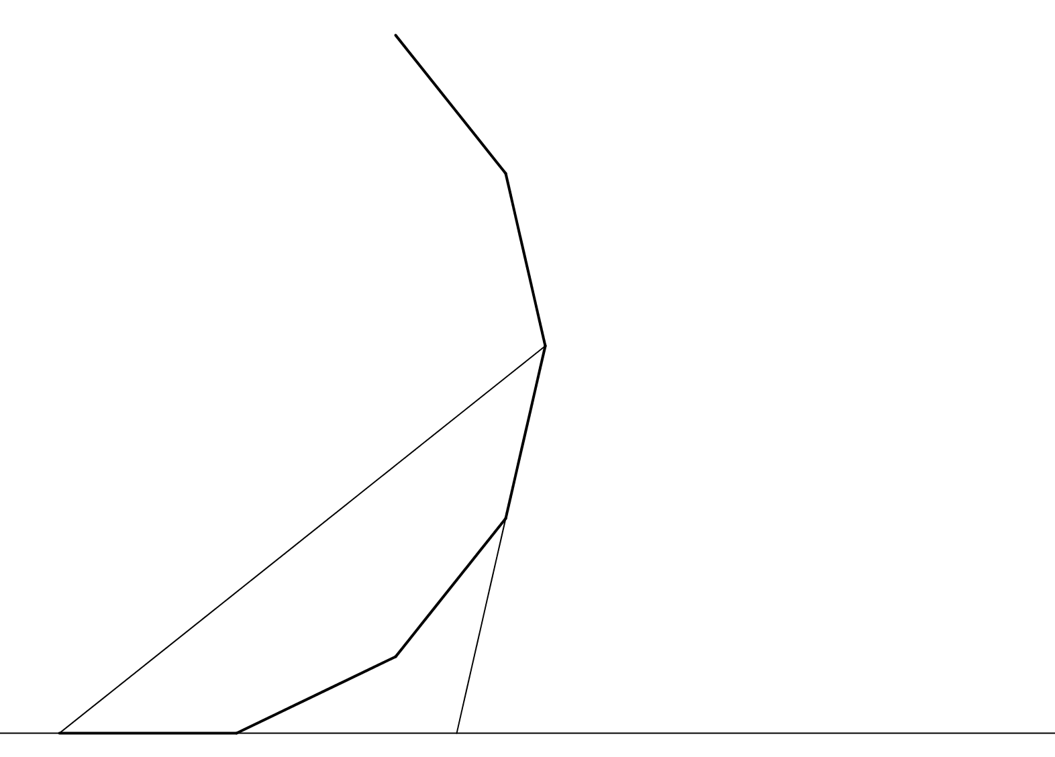
How Many Sides?
third diagonal
$$\frac{3}{2}α$$
$$\frac{3}{2}α$$
$$3α$$

Slide 10
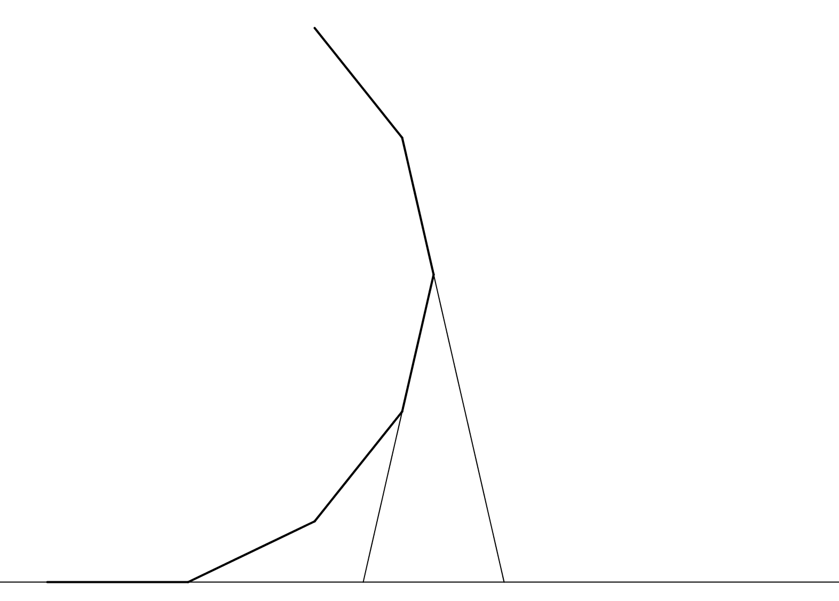
How Many Sides?
$$α$$
$$3α$$
$$4α$$

Slide 11
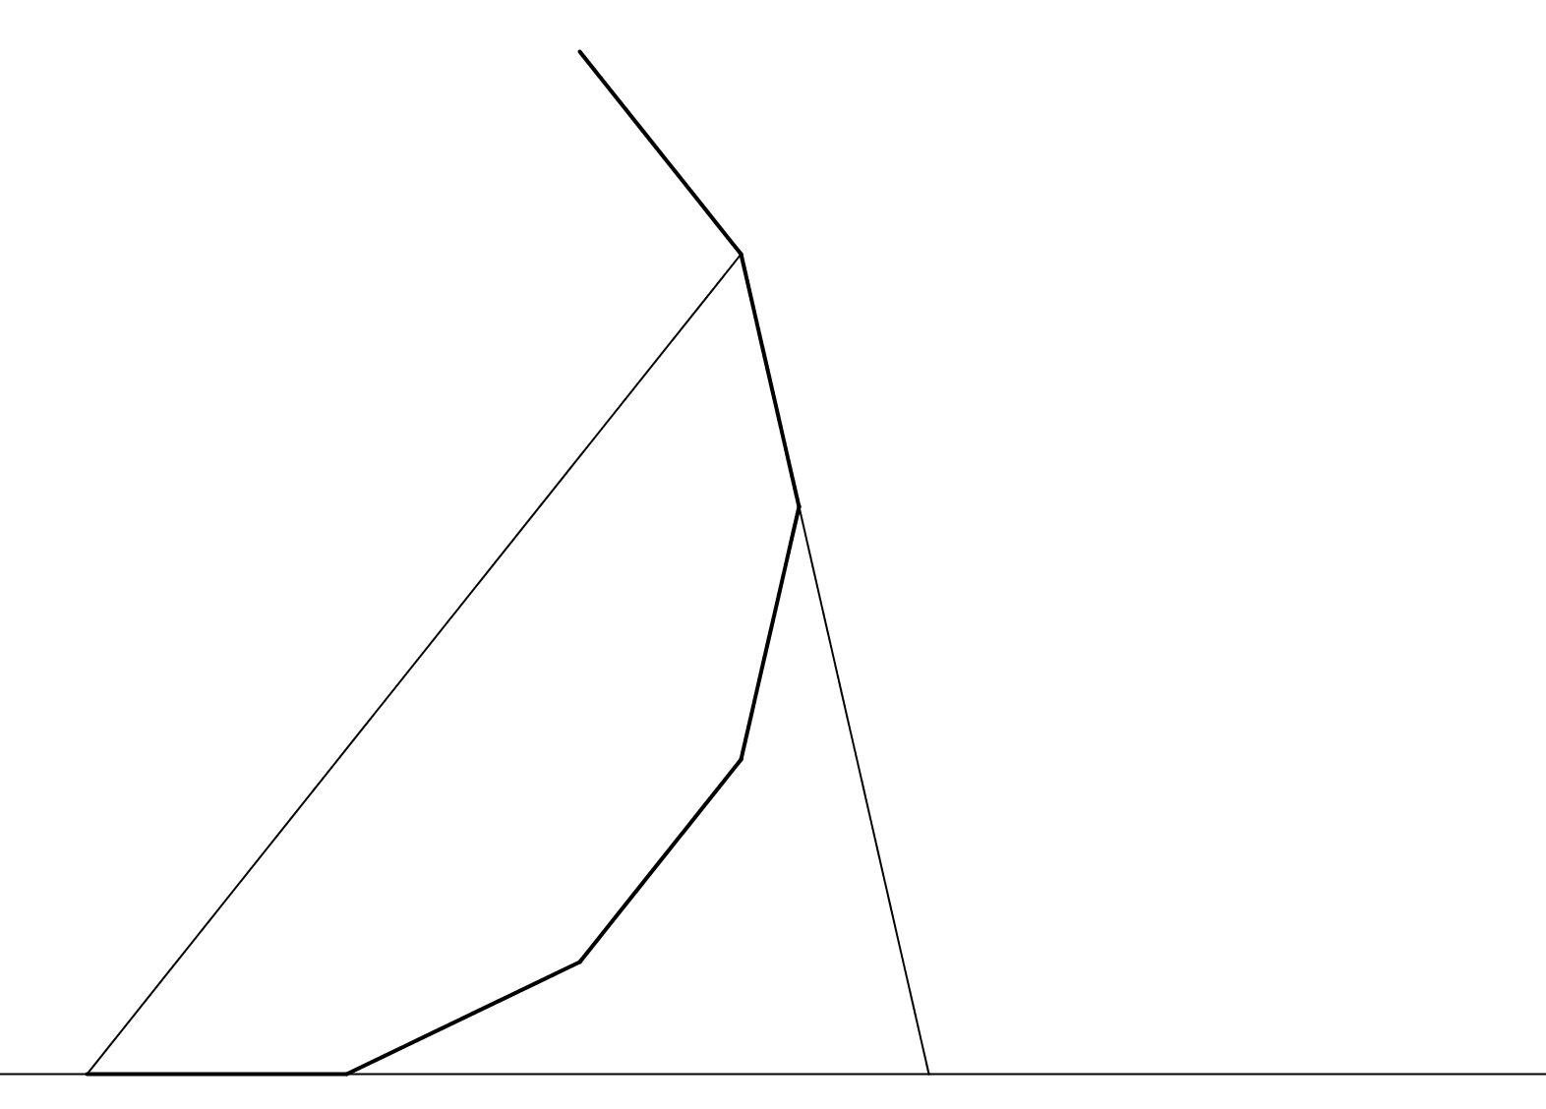
How Many Sides?
$$2α$$
fourth diagonal
$$2α$$
$$4α$$

Slide 12
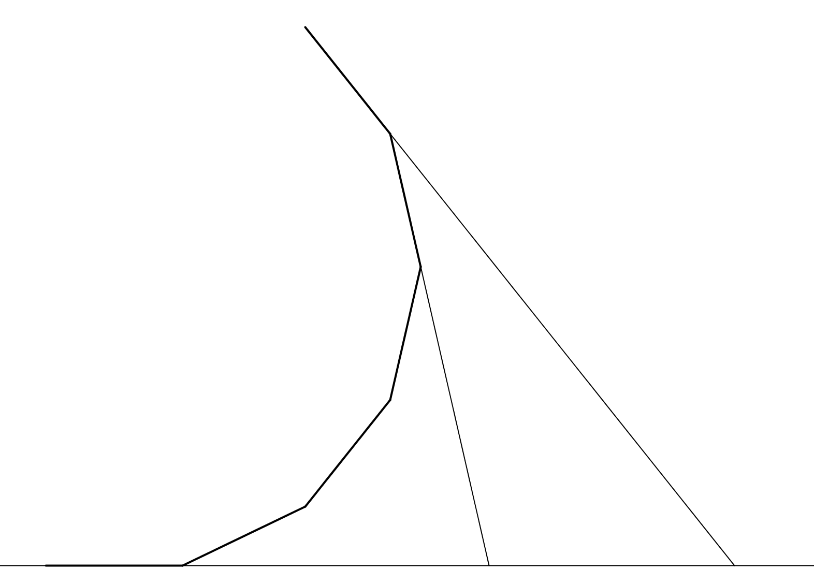
How Many Sides?
$$α$$
$$4α$$
$$5α$$

Slide 13
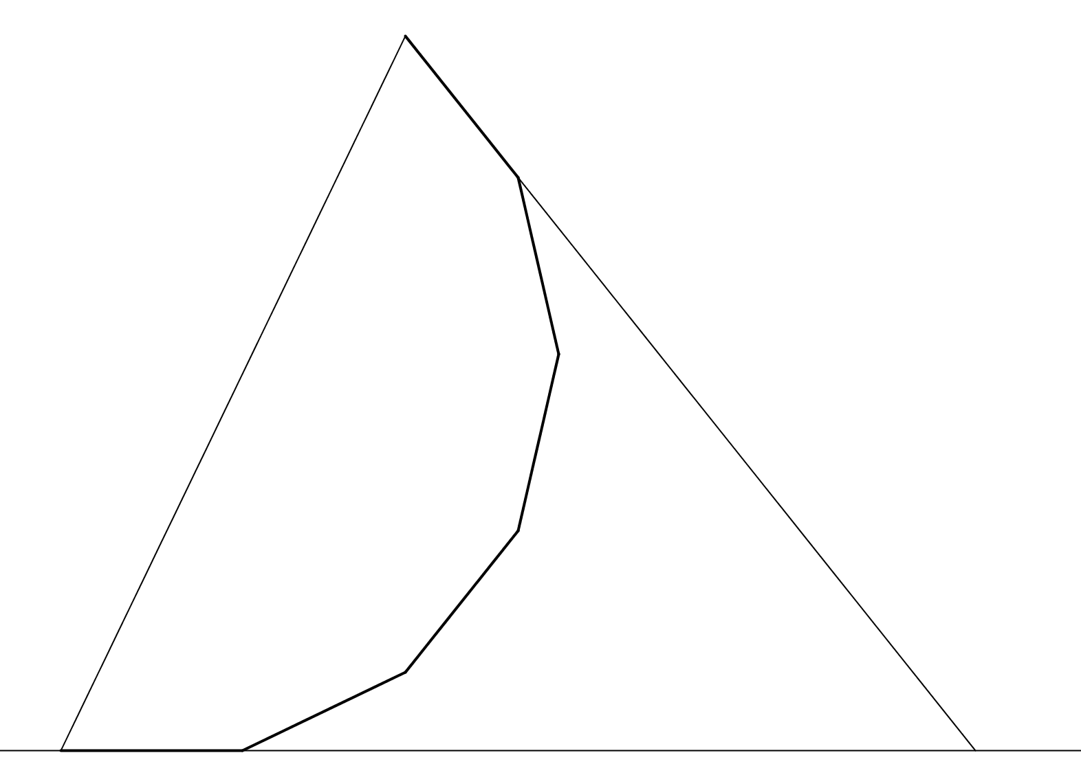
How Many Sides?
$$\frac{5}{2}α$$
fifth diagonal
$$\frac{5}{2}α$$
$$5α$$

Slide 14
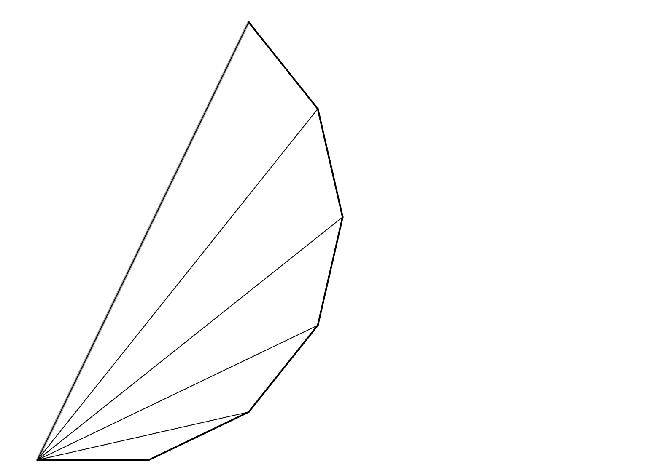
How Many Sides?
$$\frac{5}{2}α$$
These angles differ by $\frac{1}{2}α$ each step, i.e. half the external angle.
$$2α$$
So determine the external angle, $α$, then determine the number of sides of the n-gon using:
$$n=\frac{360°}{α}$$
$$\frac{3}{2}α$$
$$α$$
$$\frac{1}{2}α$$
$$∙$$
$$∙$$
$$∙$$
$$∙$$
$$∙$$
$$α$$
$$∙$$
Note that all the angles marked equal $\frac{α}{2}$ .

Slide 16
Note to Teacher
The difference between the angles shown is equal to half the external angle
So $\frac{360}{2×difference}=$number of sides
E.g. if the angles are 16⁰ and 12⁰
Then the difference is 4⁰
So number of sides = $\frac{360°}{2×4°}=45$

Slide 17
RESOURCES

Slide 18
How Many Sides?
(Not to scale)
The diagram shows part of a regular polygon and part of some diagonals of the polygon drawn from one vertex. Two angles are marked.
How many sides has the polygon?
$$16°$$
$$12°$$
SIC_47
Notes:
Answer = 45 sides

Slide 19
How Many Sides?
(Not to scale)
The diagram shows part of a regular polygon and part of some diagonals of the polygon drawn from one vertex. Two angles are marked.
How many sides has the polygon?
$$20°$$
$$15°$$
SIC_47

Slide 20
How Many Sides?
(Not to scale)
The diagram shows part of a regular polygon and part of some diagonals of the polygon drawn from one vertex. Two angles are marked.
How many sides has the polygon?
$$24°$$
$$18°$$
SIC_47

Slide 21
How Many Sides?
(Not to scale)
The diagram shows part of a regular polygon and part of some diagonals of the polygon drawn from one vertex. Two angles are marked.
How many sides has the polygon?
$$36°$$
$$27°$$
SIC_47

Slide 22
How Many Sides?
(Not to scale)
The diagram shows part of a regular polygon and part of some diagonals of the polygon drawn from one vertex. Two angles are marked.
How many sides has the polygon?
$$30°$$
$$20°$$
SIC_47

Slide 23
How Many Sides?
(Not to scale)
The diagram shows part of a regular polygon and part of some diagonals of the polygon drawn from one vertex. Two angles are marked.
How many sides has the polygon?
$$48°$$
$$36°$$
SIC_47

Slide 24
How Many Sides?
(Not to scale)
The diagram shows part of a regular polygon and part of some diagonals of the polygon drawn from one vertex. Two angles are marked.
How many sides has the polygon?
$$45°$$
$$30°$$
SIC_47

Slide 25
How Many Sides?
(Not to scale)
The diagram shows part of a regular polygon and part of some diagonals of the polygon drawn from one vertex. Two angles are marked.
How many sides has the polygon?
$$54°$$
$$36°$$
SIC_47

Slide 26
How Many Sides?
(Not to scale)
The diagram shows part of a regular polygon and part of some diagonals of the polygon drawn from one vertex. Two angles are marked.
How many sides has the polygon?
$$28°$$
$$24°$$
SIC_47
Notes:
Answer = 45 sides

Slide 27
How Many Sides?
(Not to scale)
The diagram shows part of a regular polygon and part of some diagonals of the polygon drawn from one vertex. Two angles are marked.
How many sides has the polygon?
$$35°$$
$$30°$$
SIC_47

Slide 28
How Many Sides?
(Not to scale)
The diagram shows part of a regular polygon and part of some diagonals of the polygon drawn from one vertex. Two angles are marked.
How many sides has the polygon?
$$42°$$
$$36°$$
SIC_47

Slide 29
How Many Sides?
(Not to scale)
The diagram shows part of a regular polygon and part of some diagonals of the polygon drawn from one vertex. Two angles are marked.
How many sides has the polygon?
$$45°$$
$$36°$$
SIC_47

Slide 30
How Many Sides?
(Not to scale)
The diagram shows part of a regular polygon and part of some diagonals of the polygon drawn from one vertex. Two angles are marked.
How many sides has the polygon?
$$50°$$
$$40°$$
SIC_47

Slide 31
How Many Sides?
(Not to scale)
The diagram shows part of a regular polygon and part of some diagonals of the polygon drawn from one vertex. Two angles are marked.
How many sides has the polygon?
$$72°$$
$$60°$$
SIC_47

Slide 32
How Many Sides?
(Not to scale)
The diagram shows part of a regular polygon and part of some diagonals of the polygon drawn from one vertex. Two angles are marked.
How many sides has the polygon?
$$75°$$
$$60°$$
SIC_47

Slide 33
How Many Sides?
(Not to scale)
The diagram shows part of a regular polygon and part of some diagonals of the polygon drawn from one vertex. Two angles are marked.
How many sides has the polygon?
$$72°$$
$$54°$$
SIC_47

