Slide 1
Brackets out, brackets in
Risp 3

Slide 2
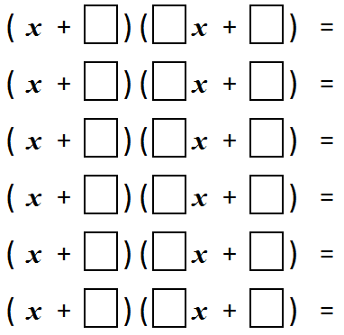
BRACKETS OUT, BRACKETS IN
Pick three different, non-zero integers between -5 and 5 that don’t sum to zero.
Place all of the permutations of these numbers in the boxes below.

Slide 3
BRACKETS OUT, BRACKETS IN
Multiply them all out.
Then add all the results together.
Now take this sum: can you factorise it?
Compare notes with your colleagues once you have tried to do this. Do you notice anything?
Does it matter what the starting list of numbers is? Can you make any conjectures? Can you prove these?

Slide 4
BRACKETS OUT, BRACKETS IN
$$a$$
$$b$$
$$c$$
$bx2 + (ab + c)x + ac$
$$a$$
$$c$$
$$b$$
$cx2 + (ac + b)x + ab$
$$b$$
$$a$$
$$c$$
$ax2 + (ab + c)x + bc$
$$b$$
$$c$$
$$a$$
$cx2 + (bc + a)x + ab$
$$c$$
$$a$$
$$b$$
$ax2 + (ac + b)x + bc$
$$c$$
$$b$$
$$a$$
$bx2 + (bc + a)x + ac$
$$2(a + b + c) x2 + 2(ab + bc + ca + a + b + c)x + 2(ab + bc + ca)$$

Slide 5
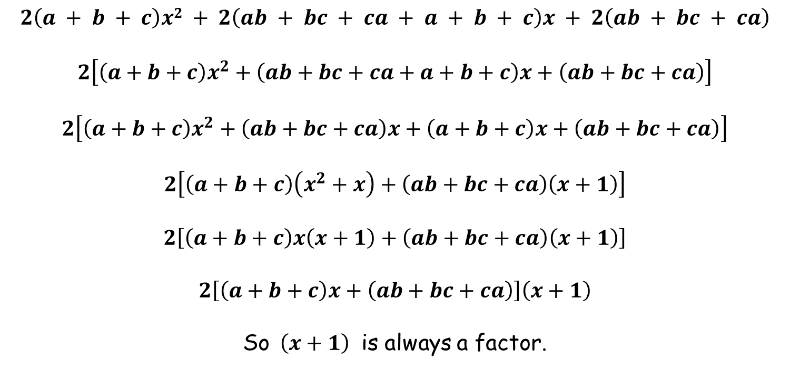
BRACKETS OUT, BRACKETS IN
$$2\left(a + b + c\right)x2 + 2\left(ab + bc + ca + a + b + c\right)x + 2\left(ab + bc + ca\right)$$
$$2\left[\left(a+b+c\right)x^{2}+\left(ab+bc+ca+a+b+c\right)x+\left(ab+bc+ca\right)\right]$$
$$2\left[\left(a+b+c\right)x^{2}+\left(ab+bc+ca\right)x+\left(a+b+c\right)x+\left(ab+bc+ca\right)\right]$$
$$2\left[\left(a+b+c\right)\left(x^{2}+x\right)+\left(ab+bc+ca\right)\left(x+1\right)\right]$$
$$2\left[\left(a+b+c\right)x\left(x+1\right)+\left(ab+bc+ca\right)\left(x+1\right)\right]$$
$$2\left[\left(a+b+c\right)x+\left(ab+bc+ca\right)\right]\left(x+1\right)$$
So $\left(x+1\right)$ is always a factor.

Slide 7
Resources

Slide 8
BRACKETS OUT, BRACKETS IN
Pick three different, non-zero integers between -5 and 5 that don’t sum to zero.
Place all of the permutations of these numbers in the boxes below.
SIC_9

Slide 9
BRACKETS OUT, BRACKETS IN
Pick three different, non-zero integers between -5 and 5 that don’t sum to zero.
Place all of the permutations of these numbers in the boxes below.
SIC_9

