Slide 1
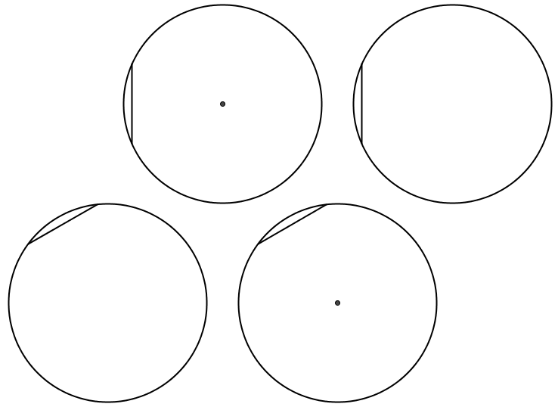
SIC_16
A
A

Slide 2
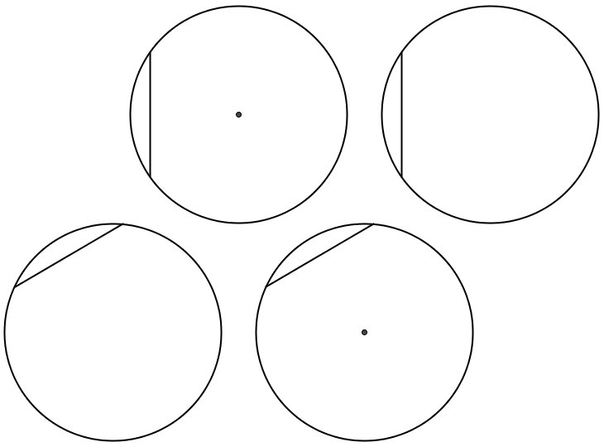
SIC_16
B
B

Slide 3
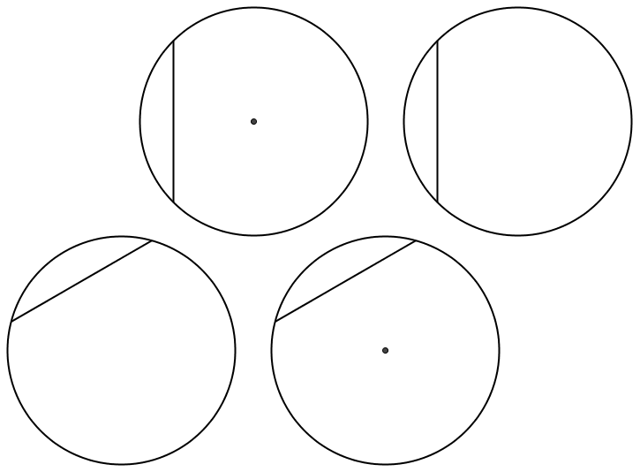
SIC_16
C
C
Notes:
45⁰ and 90⁰

Slide 4
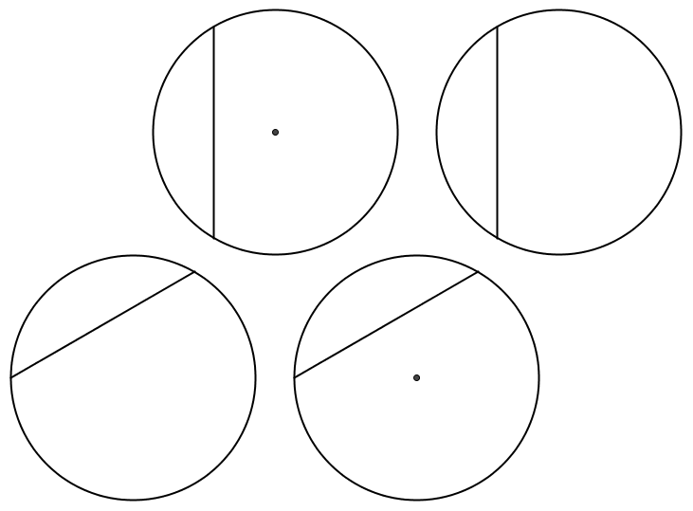
SIC_16
D
D
Notes:
60⁰ and 120⁰

